Slide 1
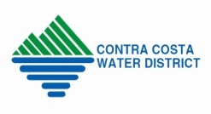
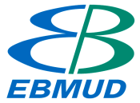
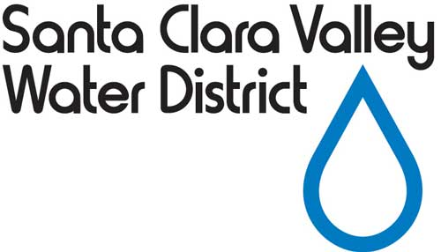
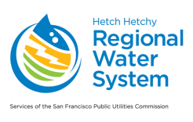
Bay Area Regional Reliability
(BARR)
North Bay Watershed Association
July 8, 2016
Presented by:
Carl A. Gowan, P.E. Principal Engineer
Marin Municipal Water District
Adapted from Alex Coate and Jerry Brown’s AWWA ACE 16 presentation, Chicago, IL

Slide 2
Background
Bay Area Regional Reliability
BARR Principles adopted by Agency Boards in May/June 2014
BARR Drought Contingency Planning (DCP) Grant obtained from Bureau - Sept. 2015
DCP Kick-off - March 2016
Notes:
BARR History
On May 27, 2014, EBMUD adopted the Bay Area Regional Reliability Principles (BARR Principles) which memorialize the mutual willingness of to develop regional solutions to improve the water supply reliability
In June of 2015 Agencies adopted the BARR Cost Share Agreement (EBMUD adopted on June 24, 2015). As part of the agreement, each agency agreed to contribute $50k toward Phase 1 and 2 of the BARR efforts, as well as support the preparation of funding applications
Also in June of 2015, EBMUD, on behalf of the BARR agencies, submitted a grant application to the Bureau of Reclamation requesting funding for the preparation of a BARR Drought Contingency Plan (DCP)
In Sept. 2015, grant funding was provided by Reclamation to cover $200,000 of the work to prepare the DCP. Participating agencies will cover the remaining costs through in-kind services and matching funds (formalized via the execution of the grant agreement at that time).
In Feb. of 2015, EBMUD entered into an Agreement with Brown & Caldwell to provide consulting support for the BARR DCP preparation

Slide 3
Eight Partner Agencies
Bay Area Regional Reliability
Contra Costa Water District
Retail Agency and Wholesaler; 500,000 customers
Marin Municipal Water District
Retail Agency; 189,000 customers
East Bay Municipal Utility District
Retail Agency; 1.4 million customers
Zone 7 Water Agency
Wholesaler; 240,000 customers
San Francisco Public Utilities Commission
Retail Agency and Wholesaler; 2.6 million customers
Alameda County Water District
Retail Agency; 344,000 customers
Bay Area Water Supply and Conservation Agency
Represents the 1.77 million wholesale customers of SFPUC
Santa Clara Valley Water Agency
Water Resource Agency for Santa Clara Co. (Wholesaler); 1.9 million customers

Slide 4
Bay Area Regional Reliability
Goals
Improve water supply reliability
Cooperative evaluation of projects
Prioritize use of existing infrastructure
May include new joint facilities
Equitable cost- and risk-sharing for future projects commensurate with the benefits received

Slide 5
Priorities
Bay Area Regional Reliability
Use existing facilities
Leverage existing contracts
Identify new projects (interties, etc.)
Review other source opportunities (recycled water, storm water, indirect and direct potable reuse, etc.)
Promote water conservation
Prepare for an uncertain water supply
The Concepts and Principles behind Bay Area Regional Reliability are aligned with the California Water Plan and with the State’s Integrated Regional Water Management Program

Slide 6
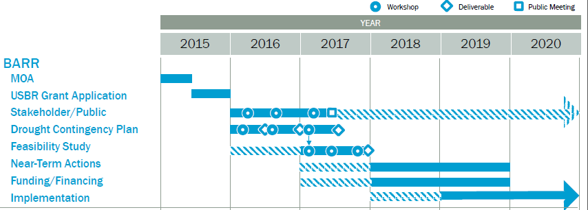
Framework
Bay Area Regional Reliability
Currently working on Drought Contingency Plan (DCP), which is an effort partially funded by the Bureau of Reclamation
Notes:
BARRD Drought Contingency Plan will be completed in Fall of 2017.
Feasibility Study and other planning efforts will continue.

Slide 7
Funding
Bay Area Regional Reliability
Costs | Funding Source
Drought Contingency Plan $ 473,500 | Grant (Bureau of Reclamation Water SMART) = $200,000
 | BARR Agencies = $273,500
DCP Subtotal | $473,500
Available for Future Work¹ = $ 126,500 | BARR Agencies = $126,500
Total = $600,000 | Total = $600,000
Notes:
1. Additional grants or agency contributions beyond $126,500 currently committed may be used to expand the future work.
Notes:
Total budget of current project plan (DCP and future planning): $600,000.
$200,000 from Reclamation grant.
$400,000 from partner contributions of equal share of $50,000 each.

Slide 8
Stakeholder Representation (Advisory Group)
Bay Area Regional Reliability
Advisory Group providing input on strategies and work products
3 meetings being held to support decision making
Notes:
Broad participation with environmental focus.
35 non-governmental agencies invited to participate
25 agencies accepted and attended the kick-off meeting on April 15, 2016.

Slide 9
Bay Area Regional Reliability
Leverage Existing Facilities
CCWD/EBMUD Interties (multiple)
EBMUD/SFPUC Intertie
SCVWD/SFPUC Intertie
Los Vaqueros Reservoir
Freeport Intake (not shown on map)
Other existing intakes, storage, conveyance, and treatment plants (not individually numbered on map)
1
1
1
4
2
3
Notes:
Agencies have billions of dollars worth of assets, both new and old.
Some fully utilized - some are not.
Under-utilized assets could be shared by other agencies for their or regional benefits.
Agency providing assets could recover capital, operational and maintenance costs.
Win – win situation.
Example:
EBMUD’s Freeport intake is not used 7 out of 10 years. Other agencies could use the intake facility, use EBMUD’s aqueducts to bring in the water for storage at Los Vaqueros or put the water use immediately. Could use one of the existing or new interties to transfer water from one region to another.

Slide 10
Bay Area Regional Reliability
Potential New Facilities
Solutions may include:
ACWD/SFPUC Intertie
EBMUD/Zone 7 Intertie
Walnut Creek Pretreatment Upgrade
SFPUC/SCVWD West Side Intertie
SFPUC/Zone 7 Intertie
Transfer-Bethany Pipeline
Regional Desalination
Advanced Water Purification Center Expansion
Well Field Expansions and Improvements
EBMUD/MMWD Intertie
Also anticipated is the expanded use of recycled water, including potable and indirect and direct potable use.
Notes:
While existing facilities could be used, potential new facilities may also prove of merit
Specifically, to leverage the maximum use and benefit from sharing existing facilities, new facilities (e.g., interties) may be needed. In addition, existing facilities may require modification or expansion (treatment plants, distribution systems, etc.)
New facilities could be built for joint use by agencies thereby lowering each agency’s capital costs share and increasing usage/benefit.
Some agencies require new facilities to enable sharing (MMWD).

Slide 11
Next Steps
Bay Area Regional Reliability
Complete the Drought Contingency Plan (by fall 2017)
Initiate feasibility work
Identify solution portfolio to improve regional reliability
Determine governance mechanisms to facilitate regional reliability (JPA’s, Inter-Agency Agreements, etc.)
Evaluate financial approaches
Federal, State, agency etc.
Notes:
Complete the DCP per Reclamation requirements.
Aside from following thru with the list of those steps noted in the slide, the agencies are committed to learn from working together as a group in these next few years, working to identify areas/projects for cooperation.
Some projects may include a subset of the partner agencies, depending on the benefits.
Further, to help pay for the proposed projects, agencies will seek grants and funding, siting that the regional cooperation and consensus that was used helps illustrate that those projects, as they have regional benefits, merit funding

Slide 12
Questions?
Bay Area Regional Reliability
Notes:
Complete the DCP per Reclamation requirements.
Aside from following thru with the list of those steps noted in the slide, the agencies are committed to learn from working together as a group in these next few years, working to identify areas/projects for cooperation.
Some projects may include a subset of the partner agencies, depending on the benefits.
Further, to help pay for the proposed projects, agencies will seek grants and funding, siting that the regional cooperation and consensus that was used helps illustrate that those projects, as they have regional benefits, merit funding

