Slide 1
Integrated Regional Water Management
Tracie Billington, P.E.
Chief Financial Assistance Branch
Department of Water Resources

Slide 2
Topics
Background statistics and funding overview
IRWM Funding
Program Preferences and Statewide Priorities
Project Selection Process
Current Solicitations
Planning Grants
Implementation Grants
Stormwater Flood Management (SWFM) Grants
Local Groundwater Assistance
Question and Answer

Slide 3
Background
Statistics and Funding

Slide 4
IRWM Region Statistics
2009 Region Acceptance Process
36 Regions Approved
10 Regions Conditionally Approved
82% Land included in a Region
Up from 54% in Prop 50
98% Population included in a Region
Up from 94% in Prop 50
Largest Region – 12.5M Acres (19,500 Mi²)
Smallest Region – 170,000 Acres (260 Mi²)
Average – 2M Acres (3,000 Mi²)
3 Regions cover entire Funding Area

Slide 5
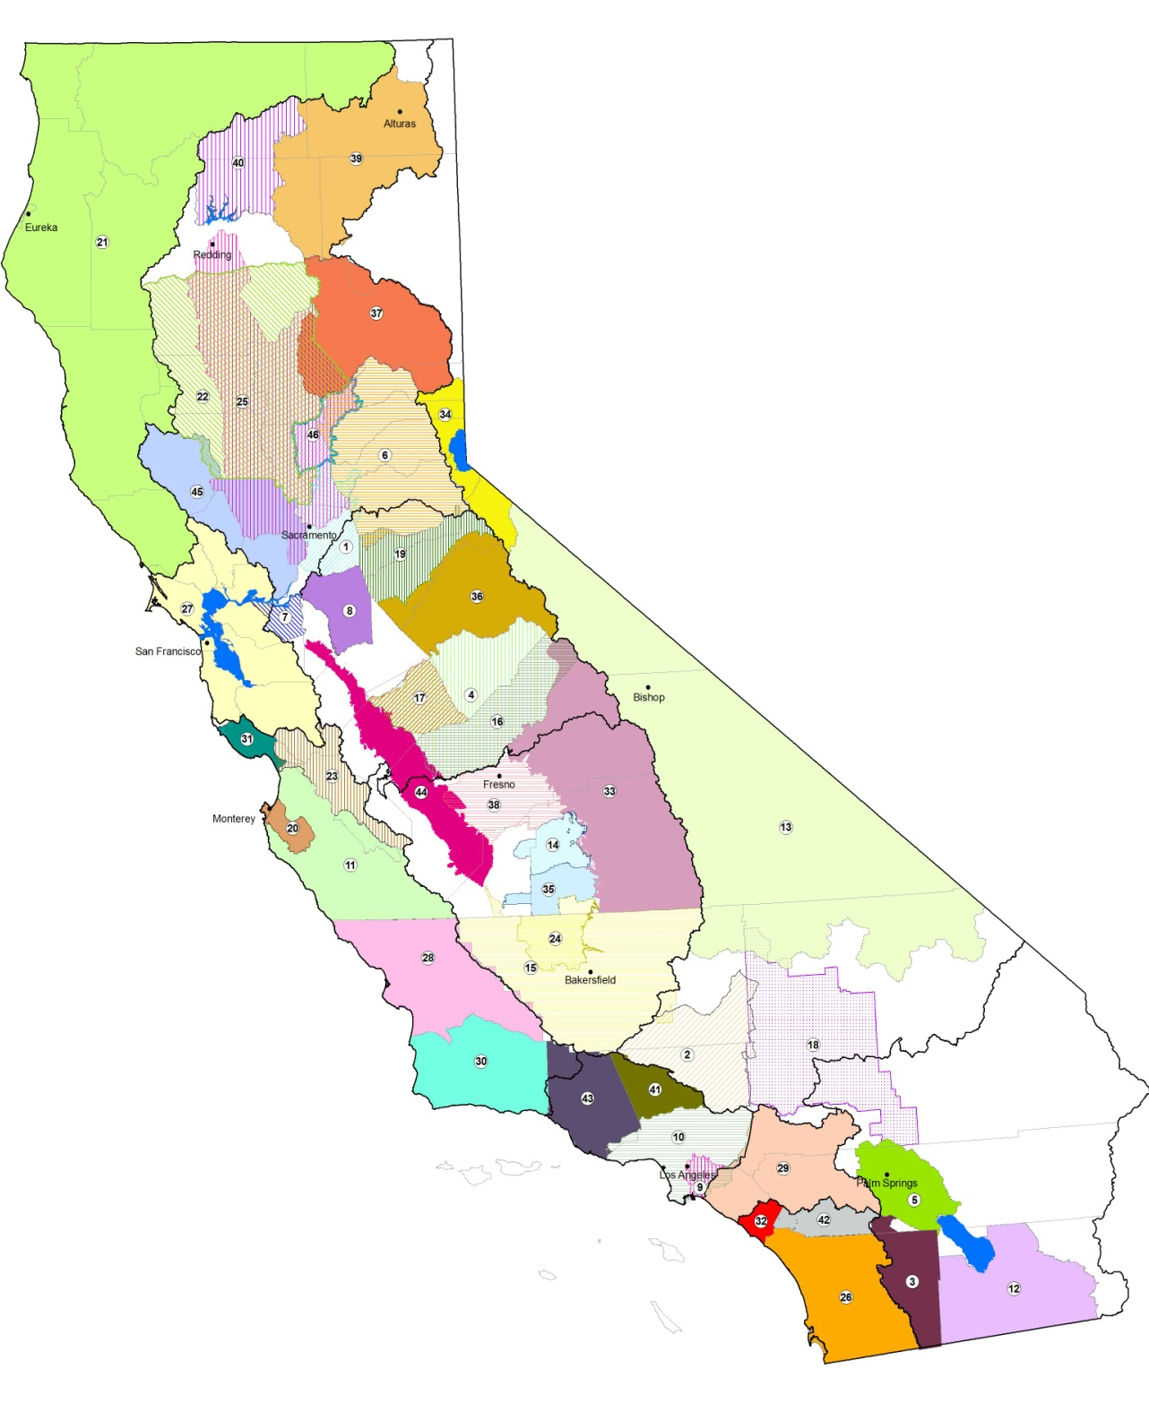
IRWM Regions
36 Approved Regions
10 Conditionally Approved Regions

Slide 6
Prop 50
Authorized $500 million in IRWM funding
Grant Program funded
Planning Grants
IRWM – $12.6M for 28 projects; total costs $21.6M
ICWM – $2.1M for 5 projects; total costs $3.2M
Implementation Grants
$365.1M to 20 proposals
213 individual projects
Total costs ~ $2B

Slide 7
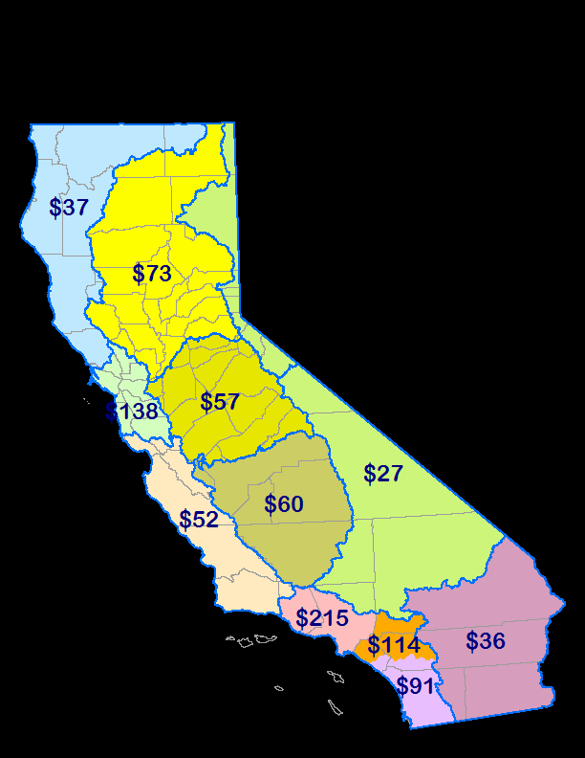
Prop 84
$1 Billion for IRWM
$900M Allocated to 11 Funding Areas
$100M Interregional
Prop 1E
$300M for SWFM
Requires consistency with IRWM Plan
$ in millions

Slide 8
Water Bond 2012?
$45
Proposed $1.05 Billion for IRWM
$1B Allocated to 12 Funding Areas
$50M Interregional
$76
$44
$132
$64
$51
$70
$58
$198
$47
$128
$87
$ in millions

Slide 9
Program Preferences

Slide 10
IRWM Program Objectives
Direct Objectives
Improve water supply reliability
Protect & improve water quality
Ensure sustainability through environmental stewardship
Higher-Level Objectives
Promote regional planning
Financial incentive to promote integration and regional cooperation and collaboration

Slide 11
Program Preferences
Preference will be given to Proposals that:
Include regional programs and projects
Effectively integrate water management
Effectively resolve water-related conflicts
Contribute to attainment of CALFED Bay-Delta Program objectives
Address critical water supply or water quality needs of disadvantaged communities (DACs)
Effectively integrate land use planning
Address Statewide Priorities

Slide 12
Statewide Priorities
Drought Preparedness
Use and Reuse Water More Efficiently
Climate Change Response Actions
Expand Environmental Stewardship
Protect Surface Water and Groundwater Quality
Improve Tribal Water and Natural Resources
Ensure Equitable Distribution of Benefits

Slide 13
Considered in Grant review
Planning Grants
10 points out of 55 points
All priorities and preferences are equal
More = Better
Reduced for uncertainty or limited benefit
Implementation Grants
10 points out of 85 points
Preference for:
Long-term drought preparedness
DAC water quality/water supply needs
Significant certainty AND
Documented breadth and magnitude

Slide 14
Project Selection Process

Slide 15
Project Selection Process
IRWM Plan Standards
Project Review Process
Procedures for submitting a project
Procedures for review of projects
Procedures for communicating selection

Slide 16
Project Selection Process
Project Prioritization
If part of plan and region follow that process, Prop 84 limits scope of DWR review
Consistency with Prop 84
Economics and Benefits part of proposal evaluation
For all implementation grant proposals
Ensure wise investments of limited state funds
Ensure projects make sense economically
Ensure projects provide desired benefits

Slide 17
Project Selection Process
Economic Analysis and Project Benefits
Water Supply
Water Quality and Other Expected
Flood Damage Reduction
Total 45 points out of 85 points
Weighted equally
Look collectively at costs and benefits
Do not require calculation of B/C ratio

Slide 18
Status of Grant Programs

Slide 19
Planning Grants
Proposals submitted September 28, 2010
Received 39 grant proposals
Requesting $27M for projects totaling $41.5M
Bay Area’s proposal was received
Total funding available $20M in Round 1
Statewide competition
50%-50% Regional/Interregional funds
$3.9M for DAC projects
By funding area allocation requirement
Draft funding recommendations – November 2010

Slide 20
Implementation Grants
Proposals due on January 7, 2011
Total funding available $100M in Round 1
Bay Area “base” allocation = $15.3M
$20M for Ag & Urban Water Conservation
$10M for DAC projects
May make more funding available in Round 1
SBx7-8 appropriation $236M for implementation grants
Different requirements than SBx2-1 appropriation
Draft funding recommendations – April 2011

Slide 21
SWFM
Proposals due on April 15, 2011
Total funding available $212M in Round 1
$100M – Seismic retrofits of existing flood control facilities
$20M – Combined municipal-storm sewer systems
$20M – Urban stream SWFM projects to reduce frequency and impacts of flooding in watersheds that drain to San Francisco Bay
Draft funding recommendations – July 2011

Slide 22
Local Groundwater Assistance Grants
Finalizing Guidelines
Solicitation pending
Total funding available $4.7M
Anticipated last round of funding
$250K grant cap
Local agencies
Improve groundwater management

Slide 23
Region Acceptance Process (RAP) 2010 Cycle
Revising 2009 RAP materials
Scheduling public review of draft
Will occur prior to Planning Grant Round 2

Slide 24
Future Solicitations
Round 2 Planning Grants
$10M
Immediately following Round 1 & 2010 RAP
Implementation Grants
Anticipate up to 2 additional rounds
$708.5M total remaining
$236M available appropriation (SBx7-8)
$472.5M future appropriation
SWFM
Anticipate 1 additional round
$57.5M future appropriation

Slide 25
Questions & Answers
Tracie Billington, P.E.
Department of Water Resources
(916) 651-9226
tracieb@water.ca.gov
http://www.water.ca.gov/irwm/
http://www.water.ca.gov/lgagrant/
http://www.water.ca.gov (then click on funding tab)

