Slide 1
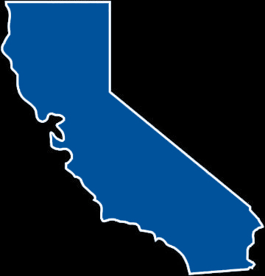
Accelerating Restoration Projects on Private Lands with the
Partners in Restoration (PIR)
Permit Coordination Program
North Bay Watershed Council, Novato CA
January 19, 2011
Analysis
Draft Recommendations
Notes:
Introduce the PIR program

Slide 2
Sustainable Conservation
501 (c)(3) non-profit organization (founded 1993)
Based in San Francisco – offices in Modesto & Burbank
Initiated Partners in Restoration (PIR) permit coordination program in 1996

Slide 3
Accelerating Restoration in California
With the Partners in Restoration (PIR) Program
Goal: Greatly increase permitted erosion control & habitat enhancement projects implemented voluntarily on private lands
Method: Programmatic permitting of specified conservation practices & environmental protection measures
Focus: Streams & adjacent uplands on farmland, ranchland, rural residential
Benefits: Improved habitat complexity & connectivity, water quality, recovery of listed species, management of working lands
Partners:
Sustainable Conservation
USDA Natural Resources Conservation Service (NRCS)
Local Resource Conservation Districts (RCDs)
Regulatory agencies
Landowners, land trusts, conservancies & others

Slide 4
Accelerating Restoration with PIR
Challenges and Opportunities
Farmers, ranchers and others are eager for restoration but face arduous and time-consuming permit process
Regulatory agencies can’t efficiently review, permit & monitor many small projects
To reach difficult sediment reduction and species recovery goals, more restoration on private land is needed
50% private land in California

Slide 5
Accelerating Restoration with PIR
California’s Forests, Waters, Fishes & Birds at Risk
Up to 95% of riparian forests removed – remaining forests fragmented and degraded
17,000 stream miles impaired by sediment
Salmon & steelhead – 10 Federal & 4 State T/E listings
Riparian-dependent T/E birds – Bank swallow, Bell’s vireo, Willow flycatcher, Yellow-billed cuckoo

Slide 6
Accelerating Restoration with PIR
PIR Supports Environmental Goals
Listed species Recovery Plans (FWS, NOAA, DFG)
TMDL sediment reduction targets (State & Regional Water Boards, EPA)
Habitat restoration (NOAA, FWS, DFG)
Watershed Planning (Local)

Slide 7
Permits Required to Repair a Stream Bank
Individual Permitting of Restoration Projects
U. S. Fish and Wildlife Service
NOAA Fisheries Service
ESA - Section 7 Consultation
U. S. Army Corps of Engineers
CWA - Section 404 Permit
County
Grading and Encroachment Permits
CEQA
CA Dept. of Fish and Game
Lake and Streambed Alteration Agreement CESA
Regional Water Quality Control Board
CWA – Sec. 401 WQ Certification
California Coastal Commission
Coastal Development Permit

Slide 8
8 Programs Implemented
Elkhorn Slough Watershed
Morro Bay Watershed
Navarro River Watershed
Marin Coastal Watersheds
Santa Cruz County
Alameda County
Yolo County Watersheds
Calleguas Creek Watershed (Ventura)
San Luis Obispo County
Santa Barbara County
Upper Pajaro River Watershed
Mendocino County
Salinas River Watershed
SLRR/Santa Margarita Watersheds (SD)
Humboldt County
Lake County Watersheds
PIR
Programs
4 Programs In Development
4 Unsuccessful/Suspended

Slide 9
Accelerating Restoration with PIR
Assessing the PIR Program
Data analysis
Survey and in-depth interviews
PIR Assessment report with recommendations
Outreach program, build support
Work to implement recommendations

Slide 10
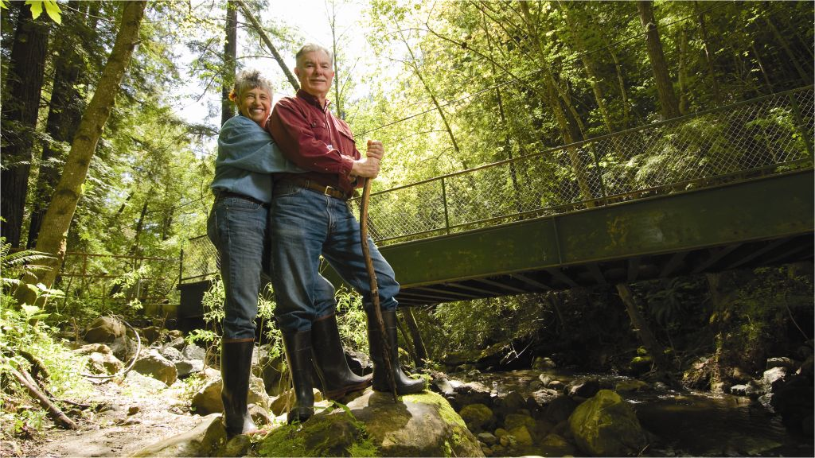
Powerhouse PIR Program Santa Cruz County
Strong RCD leadership, sizeable and trained staff
6 years’ implementation, 58 projects
11,000’ of riparian habitat enhanced, 20 stream miles opened for fish, 14,000T of sedimentation prevented
$4.5M+ leveraged for PIR projects
County Master Permit incorporates CDP under LCP
Cannot meet demand for PIR, and program renewed

Slide 11
A Winning Team Approach: Marin County PIR
Strong RCD leadership, broad community support
Projects selected by technical team w/ cooperative monitoring
5 years’ implementation, 34 diverse projects
35,000’ riparian enhanced, 16,000T sedimentation prevented
$3.8+ million leveraged for PIR projects
County – PIR program consistent with LCP
Cannot meet demand for PIR, and program renewed

Slide 12
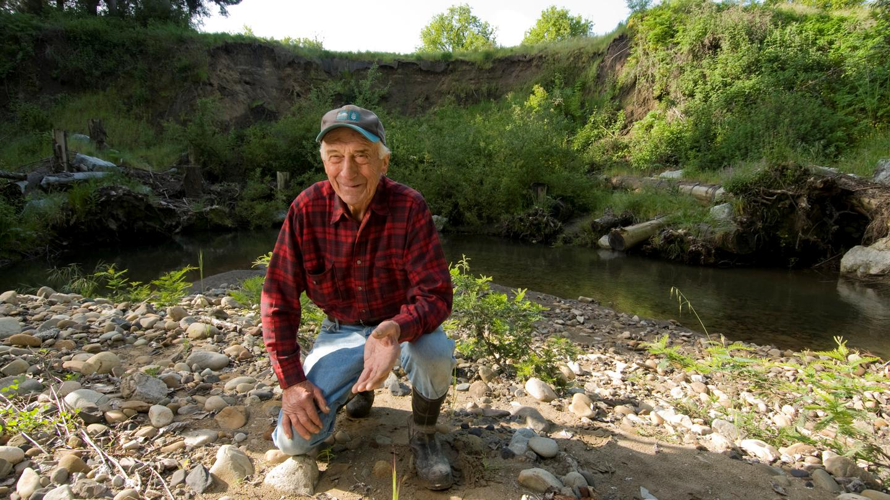
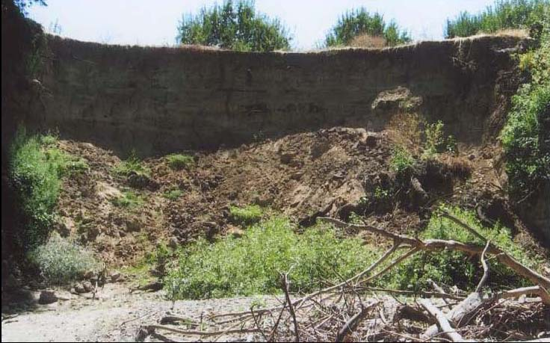
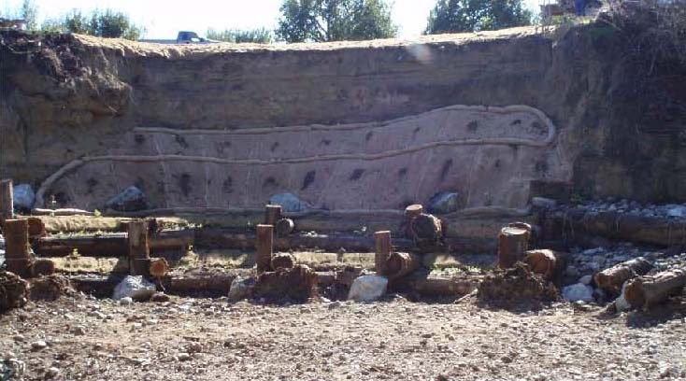
Conservation Practices Stabilize Streambanks

Slide 13
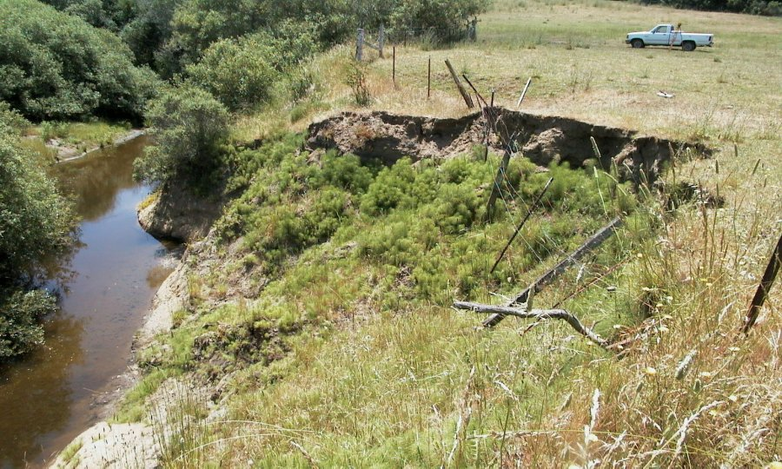
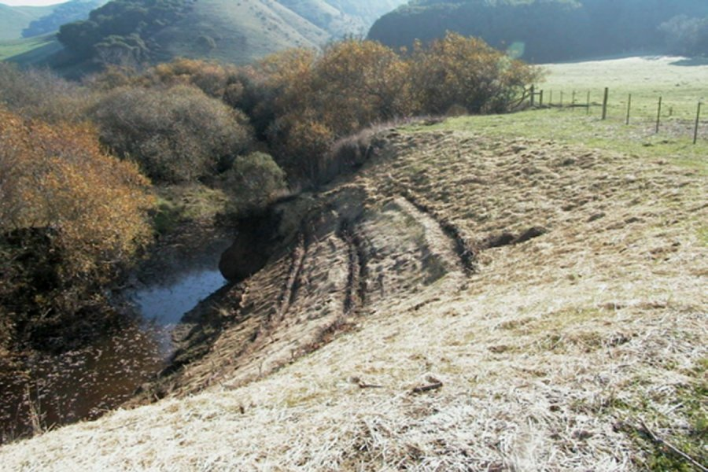
Conservation Practices Streambank Repair

Slide 14
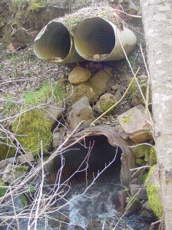
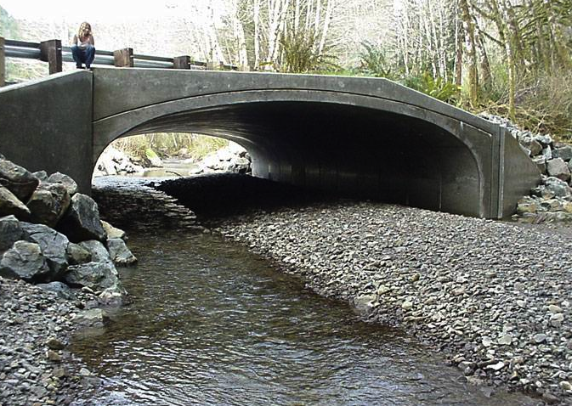
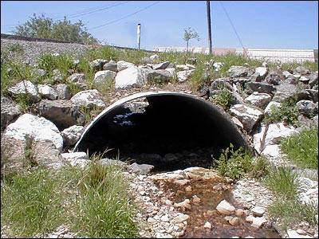
Conservation Practices Replace Old Culverts & Fill w/ Natural Bottom Culvert or Span

Slide 15
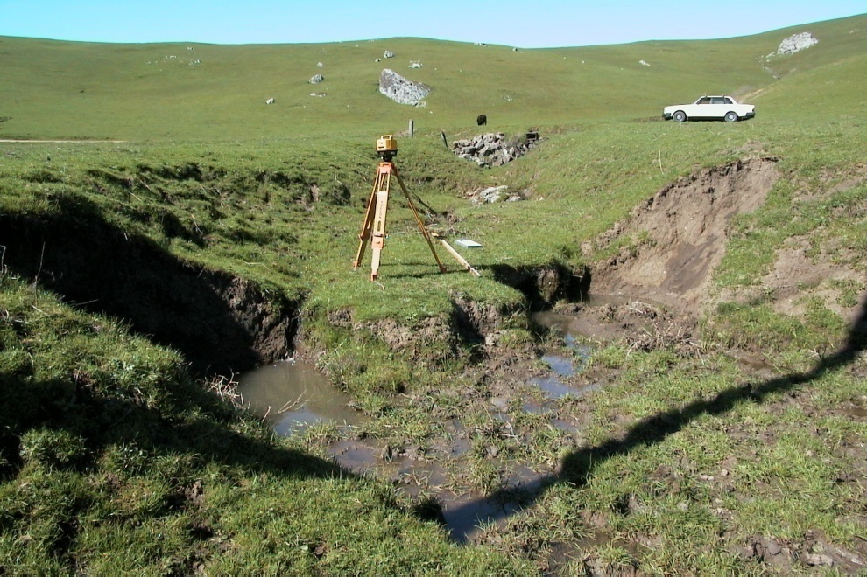
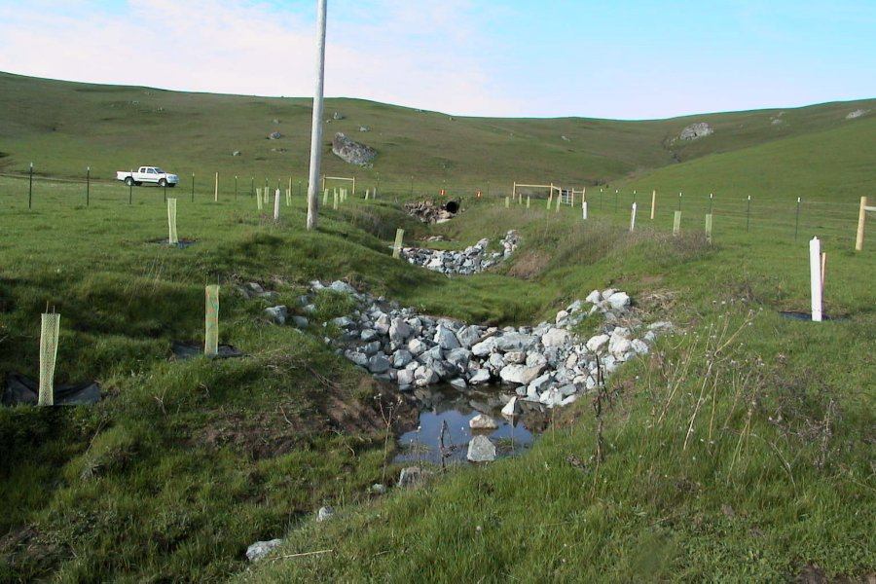
Conservation Practices Grade Stabilization

Slide 16
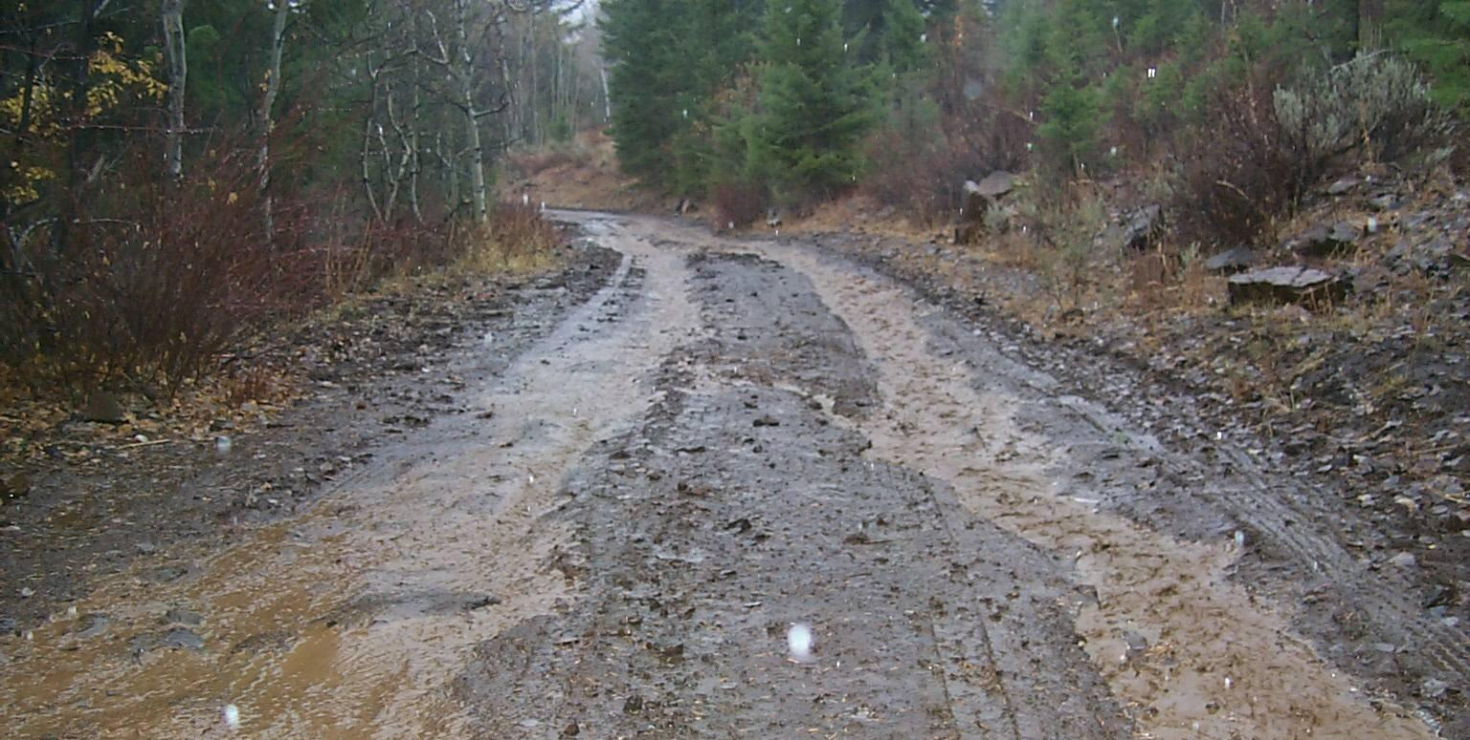
Conservation Practices Access Road Improvements

Slide 17
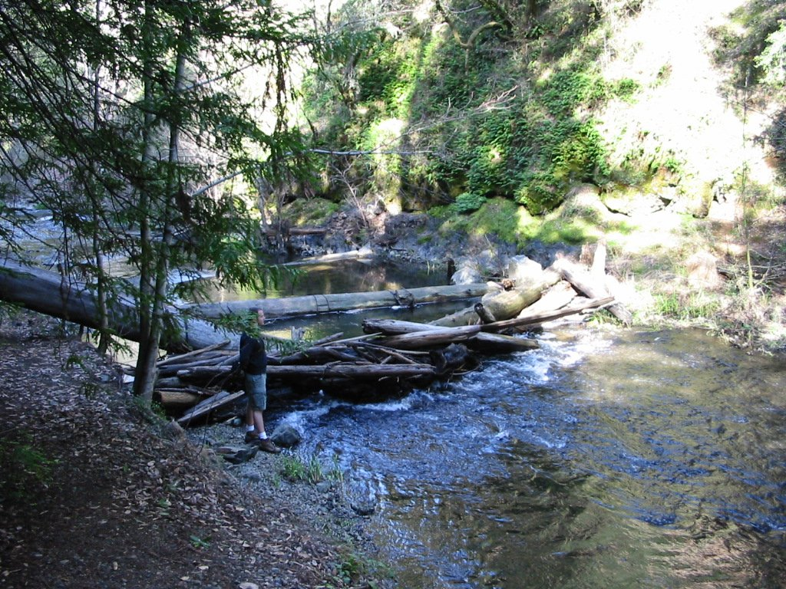
Conservation Practices Stream Habitat Improvement

Slide 18
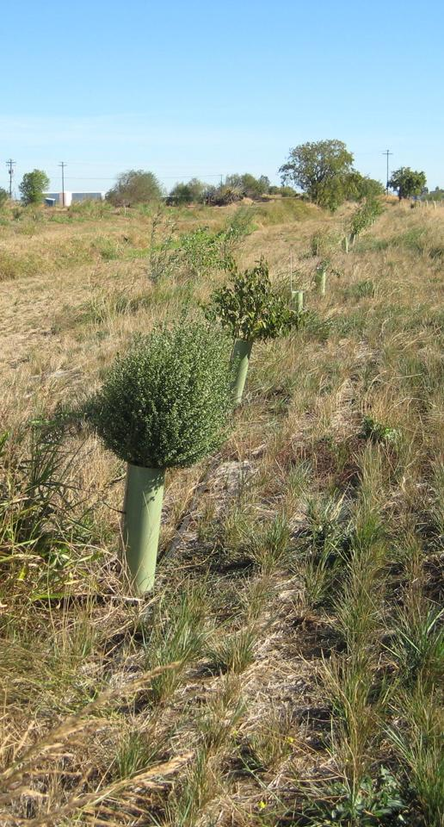
PIR Data Analysis
Overall Program Outcomes
227 projects implemented in 13 years
200,000+ tons of soil loss prevented:
Morro Bay PIR: 2,200 tons/yr
Navarro River PIR: 9,800 tons/yr
(each contributing ~ 6% toward TMDL targets)
17 miles of riparian habitat enhanced

Slide 19
PIR Data Analysis
Conservation Practices
Average # practices authorized = 13/program
Average # practices actually implemented = 7/program
Average # practices commonly implemented = 4/program
➔Selecting core set of conservation practices is feasible

Slide 20
PIR Data Analysis
Individual Program Outcomes
Average time required to develop PIR = 3.5 years 
Average cost to develop PIR = $373,000 
Average # projects installed before PIR = 1/year
Average # projects installed with PIR = 5/year

Slide 21
Comprehensive PIR Assessment
Conclusions
PIR can significantly boost the pace of restoration
Environmental protection measures for PIR considered strong/very strong
Controlling sediment & enhancing habitat helps achieve TMDL targets & species recovery goals
Successful PIR programs can help many private landowners do conservation work
PIR costly & difficult to develop but worthwhile when enough projects are implemented

Slide 22
Sustainable Conservation’s Proposal
Transition PIR permitting efforts from
watershed and countywide basis to a
statewide or multi-region program

Slide 23
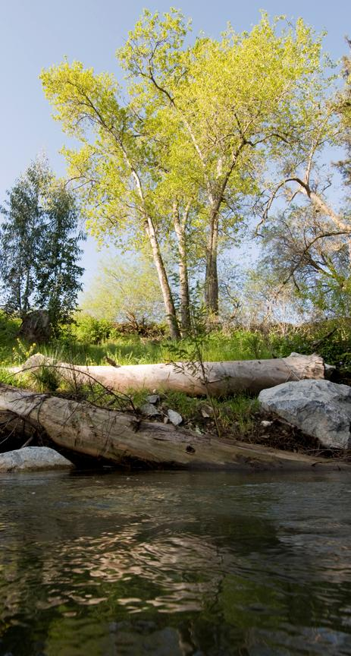
Comprehensive PIR Assessment Recommendations
Recommendation 1
Build Support for Statewide or Multi-region Restoration Program
Recommendation 2
Select Core Set of Conservation Practices & Environmental Protection Measures
Recommendation 3
Programmatic Permitting for Scaled-up PIR (DFG, CCC, SWRCB, Corps, NOAA, FWS)
Recommendation 4
Seek Exemptions from County Ordinances for Projects Regulated by Federal & State Agencies

Slide 24
Comprehensive PIR Assessment Recommendations
Recommendation 5
Standardize Monitoring & Reporting for PIR
Recommendation 6
Statewide CEQA Process for PIR & Revise CEQA Guidelines for Restoration Programs
Recommendation 7
Provide ESA & NHPA/SHPO Coverage for Entire PIR Program
Recommendation 8
Integrate Federal & State Safe Harbor Agreements into PIR Program

Slide 25
Comprehensive PIR Assessment Recommendations
Recommendation 9
Demonstrate How PIR Helps Achieve Environmental Goals & Seek Greater Funding
Recommendation 10
Increase RCDs’ Capacity for PIR Development & Implementation
Recommendation 11
Help Other Parties to Use the RCDs’ Programmatic Permits & Authorizations

Slide 26
Next Steps for PIR Assessment Process
Publish PIR Assessment report (February)
Continue outreach effort to build support
Collaborate with agencies and partners to establish statewide or multi-region restoration program (3-5 year effort) that can lead to many more restoration projects getting done

Slide 27
Thank you!
Erik Schmidt
Senior Research Analyst
415-977-0380 x334
eschmidt@suscon.org
www.suscon.org

