Slide 1
State Framework and Residential Water Use Targets

Slide 2
New Water Efficiency Bills
Water Management Planning
  AB 1668. Friedman
  SB 606. Hertzberg
Dual pieces of legislation sets efficiency targets for:
  CII
  Residential
    Indoor
    Outdoor

Slide 3
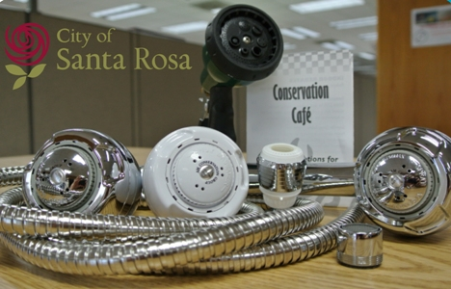
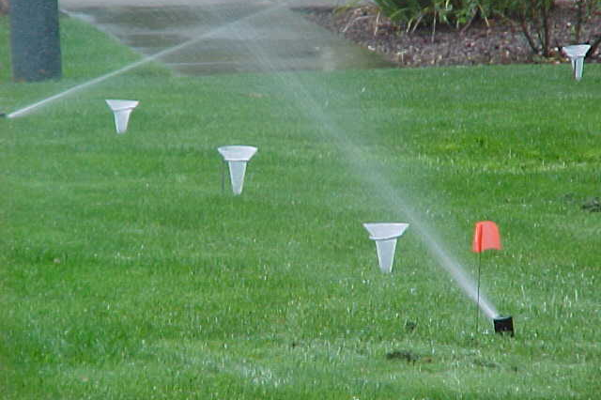
Single Family Residential Targets
Indoor Targets = 55 gpcd down to 50 gpcd by 2030
Outdoor Targets = Some percentage* of Net ET X Landscaped area
*The percentage of Net ET is complicated and will most-likely be the subject of debate in the rule-making process.

Slide 4
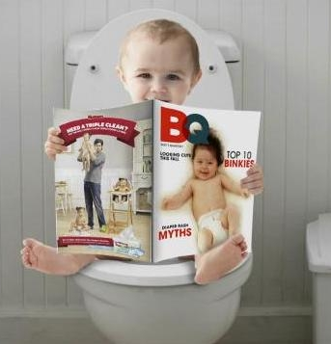
Indoor Water Budget
SFR Population X 55 GPCD X 365 days per year
Santa Rosa has an estimated SFR Pop. 115,515
Santa Rosa’s Indoor SFR Budget = 115,515 X 55 X 365 = 2.32 bg

Slide 5
Landscape Area Input
Landscape area x Outdoor standard x Net ET= Outdoor budget
DWR to measure Landscape area for all 410 urban retail water suppliers in California
DWR completed a 2 agency pilot- Padre Dam and the City of Santa Rosa
Measured landscape area for Single Family Residential

Slide 6
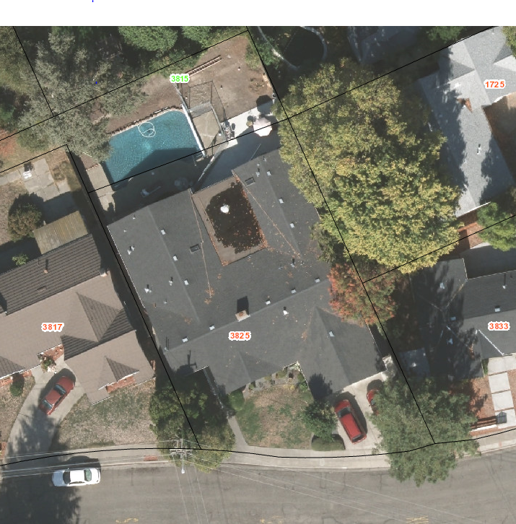
Urban Landscape Area Measurements
Classify landscapes into distinct categories (Pools, turf, trees and shrubs, hardscape, etc.,)
Combine that data into broader categories (Irrigable-Irrigated, Irrigable-Un-irrgated, Un-irrigable, hardscape)

Slide 7
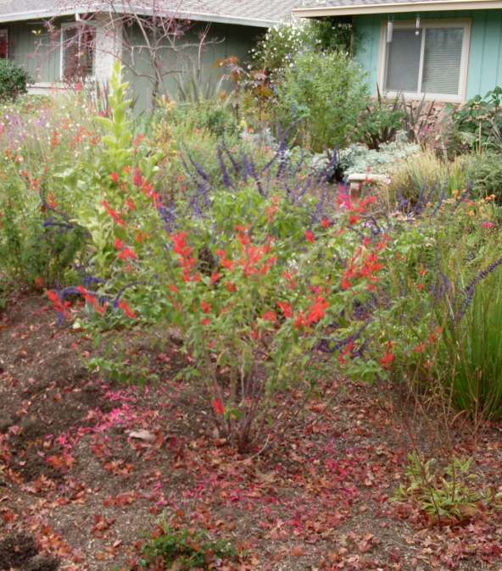
Results
DWR completed accuracy assessment
  Good results for Santa Rosa-but still have issues with Padre Dam.
  For large parcels, mapping land as undeveloped vs. irrigable-not irrigated can be subjective

Slide 8
Service Area: Single Family Irrigable Area
Padre Dam Water District: Total SF Parcel Area: 536,933, 951 sq. ft. Irrigable Area: 134,233,488
City of Santa Rosa: Total SF Parcel Area: 327,418,317 sq. ft. Irrigable Area: 144,064,059

Slide 9
Draft City of Santa Rosa Data for 2016
Total SFR Water Use = 2,671,000,000 (2.671 bg)
Indoor Water Use = Population X 55 gpcd X 365 = 2.32 bg
Outdoor Water Use = Total – Indoor = 2.67-2.32 = 0.352 bg
Irrigable Area = 144 Million feet²
Applied Water Depth = Water Volume Applied/ Area = 3.8”
Net Et = 34.5”
Water Applied = 11 % of Net Et
No WELO standard below 11% Net Et
The City would have met the target for SFR

Slide 10
Questions

