Slide 1
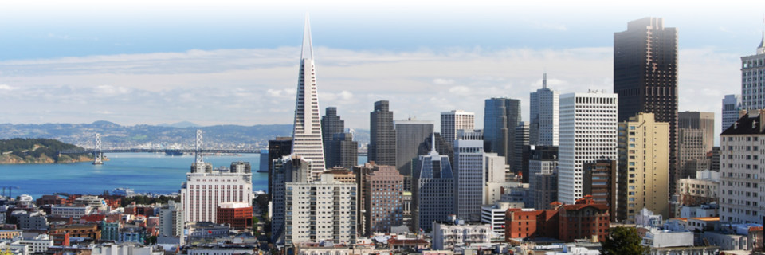
Paula Kehoe Director of Water Resources San Francisco Public Utilities Commission June 7, 2019
OneWater
Integrated Approach to Water Management

Slide 2
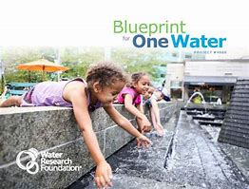
What is OneWater?
“One Water is an integrated planning and implementation approach to managing finite water resources for long-term resiliency and reliability, meeting both community and ecosystem needs.”
– Water Research Foundation, 2016

Slide 3
Moving Away from a Linear Approach to Integrated Planning and Implementation

Slide 4
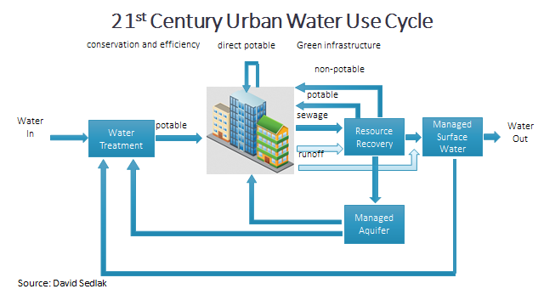
Opportunity to Establish a New Water Paradigm
Notes:
Changing urban water cycle requires new approaches to urban water management
Re-invent our systems
Build in Flexibility, resilience and reliability

Slide 5
Benefits of OneWater
Provides greater resilience and reliability
Opportunities to optimize water and wastewater infrastructure
Addresses climate change, water shortages, water quality protection, and aging infrastructure challenges
Encourages programs and projects that provide multiple benefits and collaboration

Slide 6
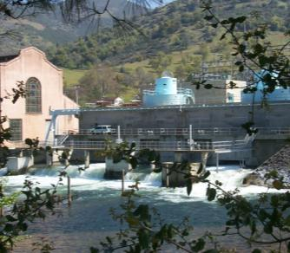
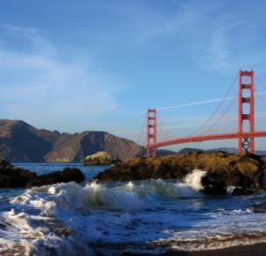
San Francisco Public Utilities Commission
Water: delivering high quality water every day
to 2.7 million people
Power: generating hydropower and solar power
Wastewater: protecting public health and the environment

Slide 7
Establishing OneWaterSF
Leadership
Working Group
Vision
Guiding Principles
Initiatives
Metrics
Notes:
How did we establish OneWaterSF?

Slide 8
Providing Leadership

Slide 9
Notes:
How do you transition to this new way of thinking?
We have found by establishing a OneWater approach it has enabled us to shift within the organization
Evolving so we are more water and resource efficient
Continue to protect public health, the environment, and provide utility service

Slide 10
Establishing a Working Group

Slide 11
Establishing a OneWaterSF Vision
With our OneWaterSF approach, San Francisco will optimize the use of our finite water and energy resources to balance community and ecosystem needs, creating a more resilient and reliable future.
Notes:
Vision= New way of Doing Business
Not just for the utility, but thinking to apply to the entire city, applicable to other city departments

Slide 12
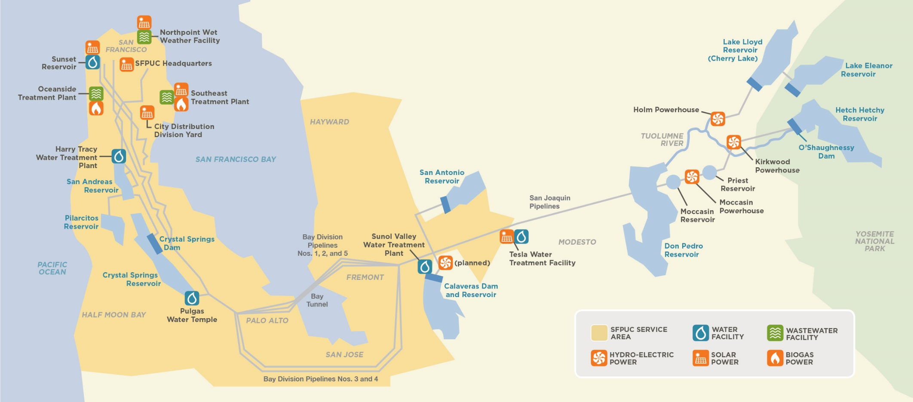
Integrating OneWaterSF
Notes:
All are as within the utility and throughout our entire service area, extending over 160 miles in CA
Planning

Slide 13
Envisioning OneWaterSF through Guiding Principles
Match the right resource to the right use.
Look holistically at our water, wastewater, and power systems to develop programs, policies, and projects that provide multiple benefits.
Plan for variable outcomes and build in flexibility to adapt to future changes.
Develop projects and programs that conserve resources and promote ecosystem health, including the health and quality of watersheds, the San Francisco Bay, and the Pacific Ocean.
Notes:
By following these Guiding Principles during the development of OneWaterSF Initiatives, we can break down silos and fuel collaboration both within the SFPUC and externally through partnerships with industry, academia, and the community. This type of thinking and collaboration fosters better recognition of the resources throughout our system, supports optimization of our operations, and inspires us to match finite water and energy resources to the right use.

Slide 14
Envisioning OneWaterSF through Guiding Principles
Work across traditional boundaries within our organization to foster collaboration that results in the efficient use of water, wastewater, energy, and financial resources.
Engage our communities to foster awareness and collaboration around OneWaterSF.
Pursue partnerships with other agencies, the private sector, and other stakeholders to generate new and creative ideas.
Pilot state-of-the-art technologies, and test new approaches to develop new business practices.
Notes:
By following these Guiding Principles during the development of OneWaterSF Initiatives, we can break down silos and fuel collaboration both within the SFPUC and externally through partnerships with industry, academia, and the community. This type of thinking and collaboration fosters better recognition of the resources throughout our system, supports optimization of our operations, and inspires us to match finite water and energy resources to the right use.

Slide 15
Viewing Our Work Within OneWaterSF
Think about OneWaterSF Guiding Principles in the early stages of a project:
Is the project designed to match the right resources to the most appropriate use(s)?
Can the project be modified to better utilize the resources of the SFPUC, or better meet the need(s) for which it is designed?
Does the project present opportunities to:
Impact or benefit other resource areas?
Work across traditional boundaries within the SFPUC to provide multiple benefits?
Partner with other agencies, private sector or others for funding or research?
Pilot state-of-the-art technologies or implement new approaches?

Slide 16
Creating OneWaterSF Initiatives
Review existing or planned projects
Identify opportunities to better leverage collaboration
OneWaterSF is city-wide and applicable on a local and regional scale

Slide 17
Matching the Right Water for the Right Use
Groundwater used for irrigation and wastewater underutilized resource
Produce recycled water for irrigation of large parks and golf courses
Save potable water and enable groundwater use for drinking

Slide 18
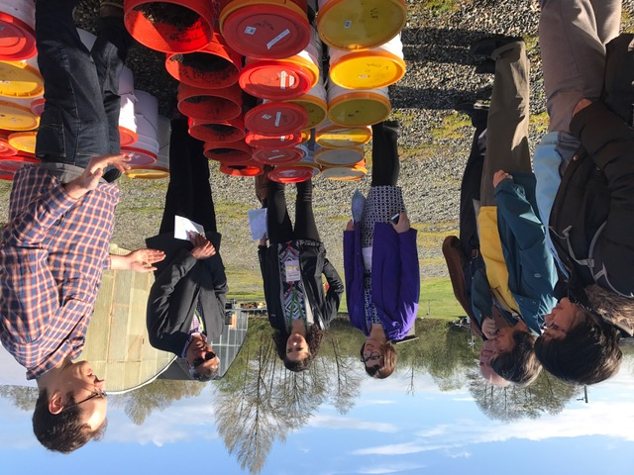
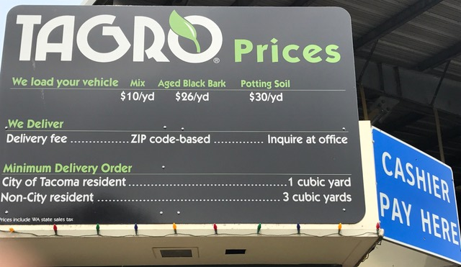
Collaborating on Biosolids Product Development
Currently half of biosolids sent to landfills for soil cover
Expand opportunities by partnering to assess feasibility of producing high quality soil replenishment

Slide 19
Pursing Partnerships to Generate New and Creative Ideas
Ocean Beach Climate Change Adaptation Project
SFPUC in partnership with other city, state and federal agencies to develop comprehensive vision
Projects address sea level, protect infrastructure, restore coastal ecosystems and improve public access

Slide 20
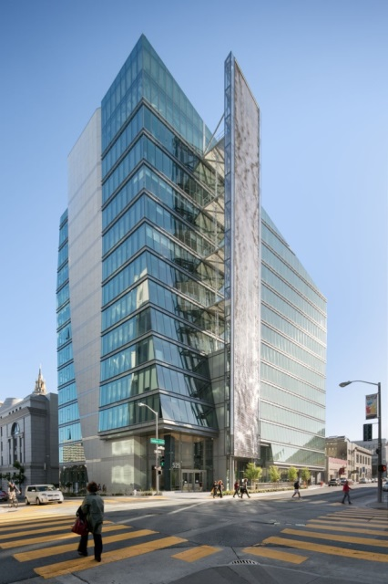
Piloting State-of-the-Art Technologies and Creating New Business Practices
Onsite Reuse
Innovations Program
Breweries
Atmospheric water generation
PureWaterSF
Leak Detection Technologies

Slide 21
Promoting Efficient Use of All of our Resources
Issuing Green Bonds to address financial resources
Green and impact investors value work to reduce climate risk and social impacts
Increasing demands for Green Bond can lower costs for our ratepayers

Slide 22
Working Across Traditional Boundaries on a Regional Scale
Irrigate City owned golf courses with recycled water
Partnerships with City of Daly City and North Coast County Water District
Leverage existing infrastructure

Slide 23
Pursuing Partnerships for Drought Measures
Regional project in partnership with Daly City, San Bruno and Cal Water (current groundwater pumpers)
Groundwater extraction during multi-year drought
Propose 16 wells to extract 7.2 mgd for 7.5 years
In-Lieu Recharge Project

Slide 24
Planning to Adapt to Future Changes
BARR provides forum to leverage existing interconnections with neighboring water providers to build in flexibility
Explore options for additional synergies and new water supplies
Strengthen water supply reliability for over 7 million residents

Slide 25
Reporting on Progress of OneWaterSF
Publish reports
Presentations
Metrics

Slide 26
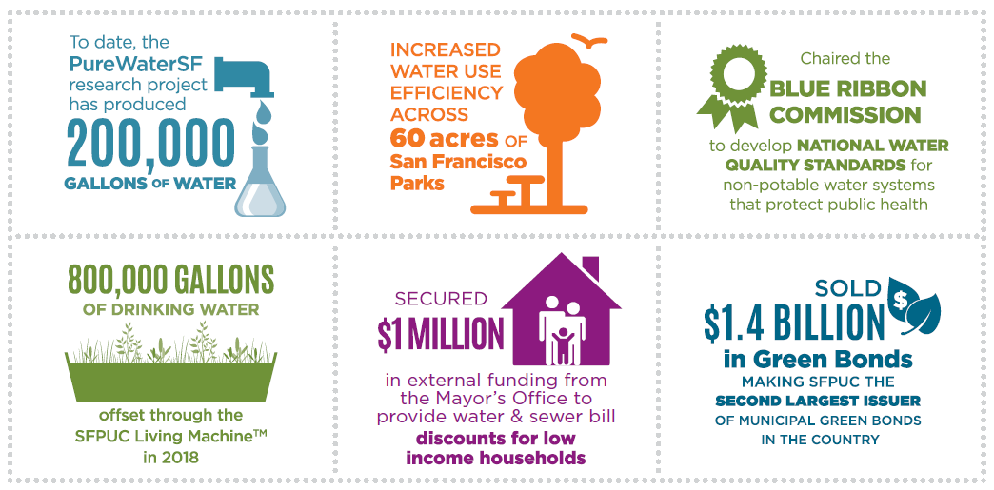
OneWaterSF Metrics

Slide 27
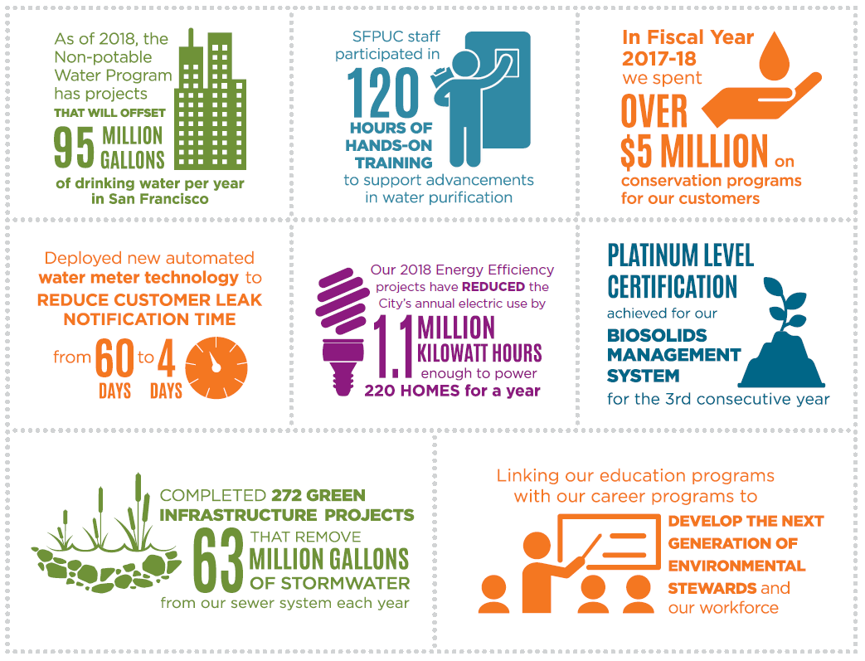
OneWaterSF Metrics

Slide 28
OneWater Los Angeles
OneWaterLA Plan: water reuse, stormwater capture, community assets and green infrastructure
Additional Initiatives:
Recycle 100% of wastewater (water and sanitation partnerships)
Los Angeles Green New Deal

Slide 29
Hampton Roads Sanitation District
Consent decree to eliminate sanitary sewer overflows
Groundwater recharge with purified water
Reduce nitrogen and phosphorus discharges

Slide 30
Seattle Public Utilities
Environmental Justice and Service Equity Division
Equity toolkit to understand unintentional racial socioeconomic disparities that may be created from a policy, service, program or project

Slide 31
New York City
OneNYC2050
Integrated planning for environmental sustainability, economic equality, and social justice

Slide 32
Reflecting on OneWaterSF
OneWater is really about a change in thinking, a cultural shift
Embrace new partnerships/opportunities to achieve better outcomes
Creative, collaborative thinking and solutions

Slide 33
Reflecting on OneWaterSF
OneWater can originate from many different places
Inspires and enables staff to re-imagine our future infrastructure

Slide 34
pkehoe@sfwater.org sfwater.org sfwater.org/onewatersf
Thank You

