Slide 1
One Water Approach for the North Bay
Presented to North Bay Watershed Association
July 12, 2019

Slide 2
Presentation Purpose
Provide background on the One Water concept
Review water resource management issues in the North Bay Area appropriate for One Water
Present example North Bay projects that demonstrate One Water principles
Provide recommendations on how NBWA could serve to facilitate a One Water approach in the North Bay

Slide 3
One Water Concepts
Appreciate the interconnectedness of the water cycle and value of resources
According to APA’s 2016 Water Policy Guide:
      “An urban water cycle [is] a single, integrated system, in which all urban water flows are recognized as potential resources, and the interconnectedness of water supply, groundwater, stormwater and wastewater is optimized, and their combined impact on flooding, water quality, wetlands, watercourses, estuaries and coastal waters is recognized.”

Slide 4
Hydrologic Cycle
Source: DWR 2016

Slide 5
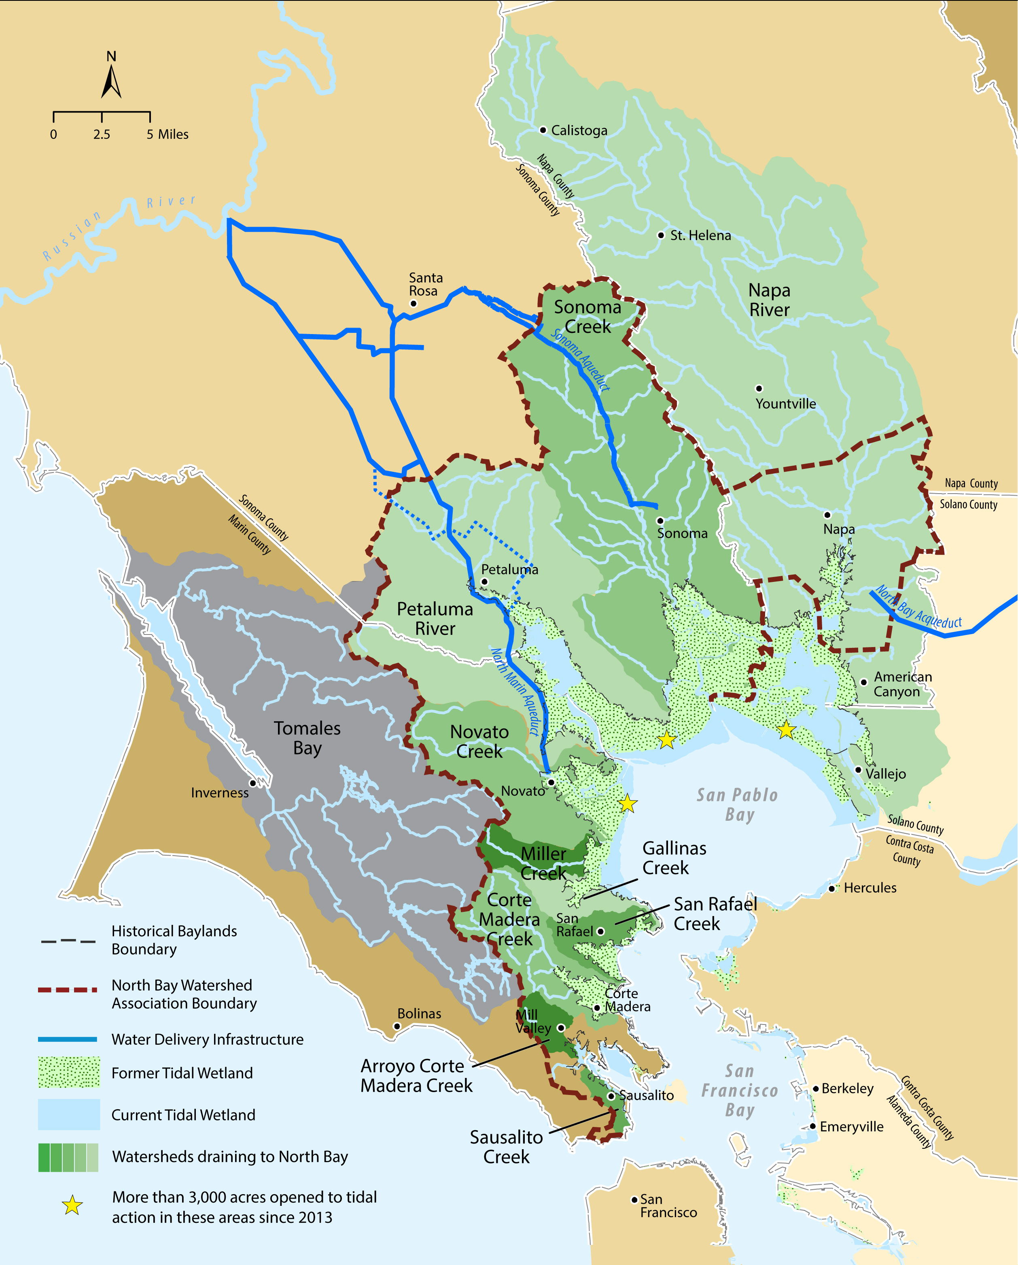
One Water Concepts
Example IRWM Round 2 Projects
  Integrated, regional water management
  Greater coordination among diverse interests, stakeholders, and decision-makers
  Avoid “siloing,” communicate between departments
Petaluma Flood Impact Reduction, Water& Habitat Quality, Recreation for Capri Creek
Lagunitas Creek Watershed Sediment Reduction and Management Project
Napa Milliken Creek Flood Damage Reduction and Fish Passage Barrier Removal
  One Water seeks to truly integrate water management across the hydrologic cycle vs. only being a regional funding program
Source: NBWA 2019
Notes:
Example IRWM Round 2 Projects:
Lagunitas Creek Watershed Sediment Reduction and Management Project (MMWD): This project improves the Jewell Creek stream crossings of the Cross Marin Trail, which runs parallel to Lagunitas Creek. The stream crossing improvements involve replacing an old and failing culvert with a larger culvert.
Petaluma Flood Impact Reduction, Water & Habitat Quality, Recreation for Capri Creek (City of Petaluma): This project consists of defined site treatments for approximately 1 ,400 linear feet of creek and approximately 3,200 linear feet of creek frontage along upland areas. This project consists of construction of flood terraces and channel reconfiguration to address flooding and water quality issues, increase groundwater recharge; improve upland and riparian habitat; increase recreational and public education opportunities; and sequester carbon in improved riparian and upland habitats.
Napa Milliken Creek Flood Damage Reduction and Fish Passage Barrier Removal (County of Napa): This project involves up to three integrated elements to reduce flooding in neighborhoods adjacent to Milliken Creek: 1) approximately 300 cubic yards of dam/fill materials removed and approximately 0.52 acres of stream restoration, 2) construction of a flood bypass/weir to ensure a flood detention area does not overflow into neighboring homes, and 3) minor grading and drainage improvements to further protect adjacent, low-lying properties.

Slide 6
One Water Bay Area Example: SFPUC
SFPUC’s OneWaterSF plan seeks to optimize use of finite resources to balance community and ecosystem needs, creating a more resilient and reliable future
As described by Paula Kehoe in the June 2019 NBWA Board Meeting, this approach has led to many great and innovative projects
Source: SFPUC 2016
Notes:
SFPUC projects include:
Producing recycled water for irrigation of large parks and golf courses – “Matching right water for the right use.”
Collaborating on biosolids product development; assessing feasibility of using biosolids to make high quality soil replenishment.
Ocean Beach Climate Change Adaptation Project – SFPUC partnered with other city, state, and federal agencies to develop comprehensive vision.
Pilot projects for on-site potable water reuse - PureWaterSF

Slide 7
One Water Example: SFPUC Principles
Match the right resource to the right use.
Look holistically at our water, wastewater, and power systems to develop programs, policies, and projects that provide multiple benefits.
Plan for variable outcomes and build in flexibility to adapt to future changes.
Develop projects and programs that conserve resources and promote ecosystem health, including the health and quality of our watersheds, the San Francisco Bay, and the Pacific Ocean.
Work across traditional boundaries within our organization to foster collaboration that results in the efficient use of our water, wastewater, energy, and financial resources.
Engage our communities to foster awareness and collaboration around OneWaterSF.
Pursue partnerships with other agencies, the private sector, and other stakeholders to generate new and creative ideas.
Pilot state-of-the-art technologies, and test new approaches to develop new business practices.

Slide 8
One Water Example: Valley Water
Valley Water’s One Water Plan integrates the water supply, flood protection, and stream stewardship missions at the watershed scale
  Tier I: Countywide framework
  Tier II: Master Plan for each of the five major watersheds in Valley Water’s jurisdiction

Slide 9
North Bay Water Resources Issues
One Water
Sustainable Water Supply
Sustainable Groundwater
Protecting and Enhancing Aquatic Habitats
Climate Change and Sea Level Rise
Water Quality
Flood Management

Slide 10

Sustainable Water Supply
NBWA member agencies obtain water from various sources:
  Local runoff
  Imported water
  Recycled water
  Groundwater
One Water opportunities include recycled water/reuse applications, regional coordination around alternate sources, continued conservation
Source: MMWD 2019

Slide 11
Sustainable Groundwater
Sustainable groundwater management now required through SGMA. NBWA includes three basins subject to SGMA:
  Petaluma Valley Groundwater Basin (medium priority)
  Napa-Sonoma Valley Groundwater Basin, Sonoma Valley Subbasin (high priority)
  Napa-Sonoma Valley Groundwater Basin, Napa Valley Subbasin (high priority)
One Water opportunities include continued and expanded inter-agency, regional coordination on groundwater recharge and storage projects
Source: Petaluma Valley GSA 2019

Slide 12
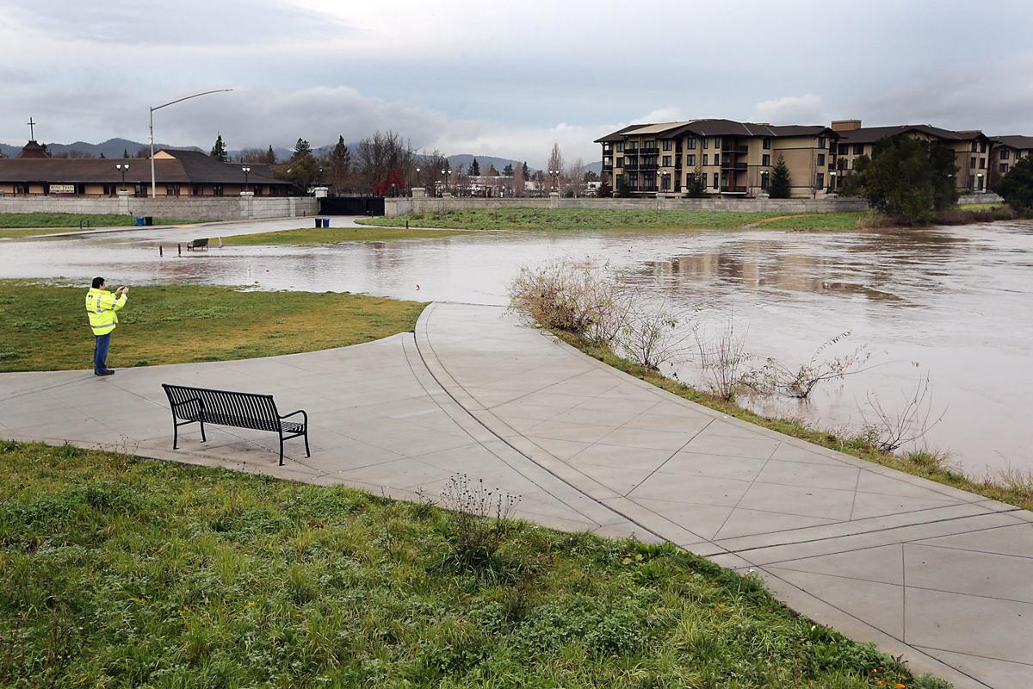
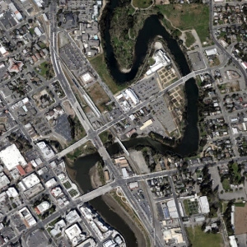
Flood Management
No major dams/reservoirs within NBWA area managed solely for flood protection, although levees protect some low-lying areas
One Water opportunities include regional coordination on multi-benefit projects (e.g., floodplain and wetland restoration)
Source: Napa Valley Register 2017
Source: California WaterBlog 2015

Slide 13
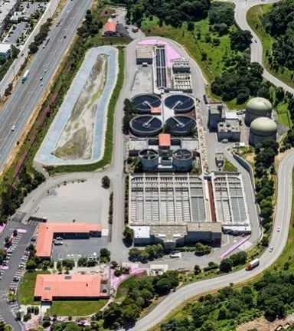
Water Quality
Many water body segments in the NBWA area identified as impaired under CWA, Section 303(d):
  Napa River, Mare Island Strait
  Napa River, non-tidal
  Napa River, tidal
  Petaluma River
  Petaluma River, tidal portion
  Richardson Bay
  San Francisco Bay, Central
  San Pablo Bay
  Sonoma Creek, non-tidal
  Sonoma Creek, tidal
One Water opportunities include multi-benefit projects (e.g., wetland restor-ation, green stormwater infrastructure)
Source: Central Marin Sanitation Agency 2019

Slide 14
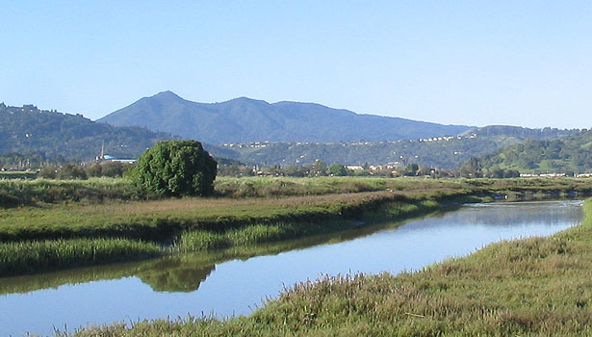
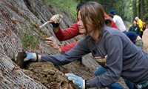
Protecting and Enhancing Aquatic Habitats
There are many sensitive habitats and special-status species potentially present in the North Bay
Habitat restoration projects are on-going, but could be expanded and integrated with other objectives as part of a One Water approach
Source: Marin County Parks 2019
Source: MMWD 2019

Slide 15
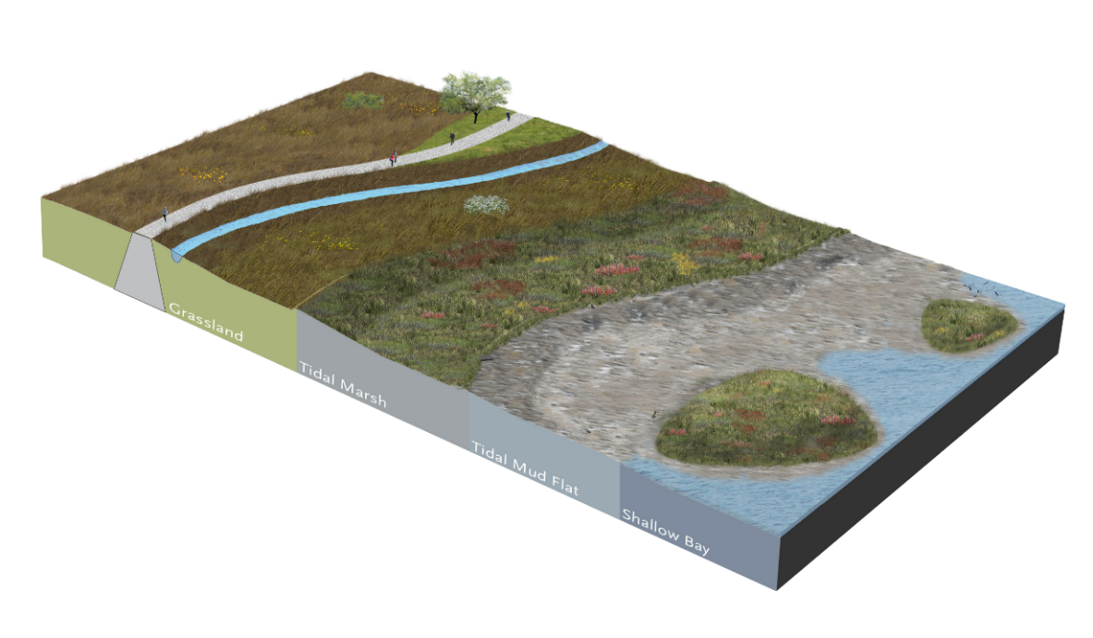
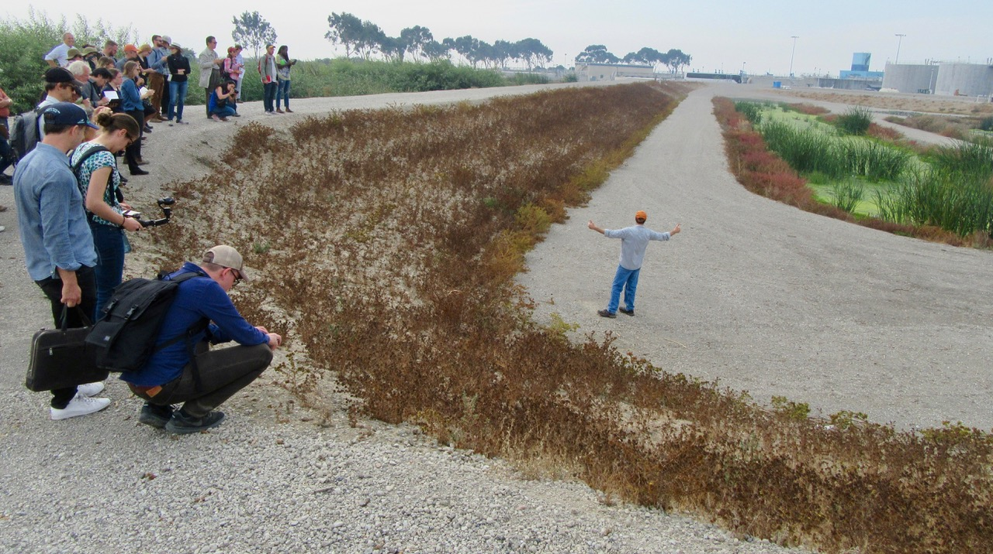
Climate Change and Sea Level Rise
  Models predict further climate warming and sea level rise, which will increase flood risk and impact shore-line properties and habitats in the North Bay
  One Water opportunities include regional coordination and innovative, multi-benefit solutions/projects
Source: The Bay Institute 2019
Source: SF Estuary Partnership 2019

Slide 16
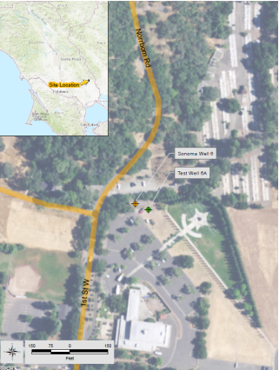
Example Project #1: Groundwater Banking
Inter-agency effort in Sonoma County to identify groundwater banking opportunities
Pilot Aquifer Storage and Recovery (ASR) project being developed in City of Sonoma
Increase regional water supply reliability and also improve aquatic habitat (by enhancing tributary flows, thereby improving conditions for listed salmonids)
Source: Sonoma County Water Agency 2017

Slide 17
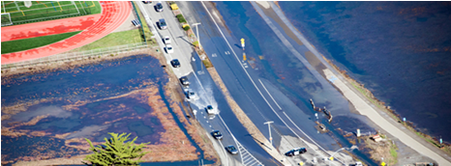
Example Project #2: BayWAVE
Focused vulnerability assessment of Marin County shoreline to sea level rise
Many critical infrastructure assets (e.g., roads, transit, medical facilities, etc.) are potentially vulnerable
Next steps include coordination with communities to plan for adaptation
Source: County of Marin 2019
Notes:
The photo is an example of a King Tide in Mill Valley, which gives a glimpse of potential future sea level rise effects

Slide 18
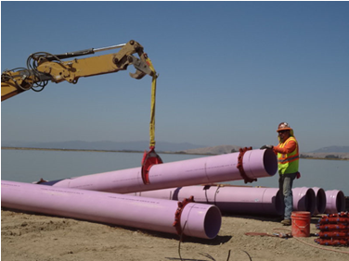
Example Project #3:
North Bay Water Reuse Program
Regional water recycling and management initiative covering 315 square miles in portions of Marin, Sonoma and Napa counties
Developed by North Bay Water Reuse Authority
Will offset potable demand and reuse treated wastewater, which has not historically been considered a resource of value
Source: NBWRA 2019

Slide 19
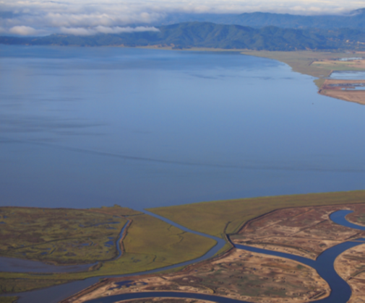
NBWA’s Role in a One Water Approach
  NBWA already serves to facilitate inter-agency, regional coordination on water resource management issues
  Board meetings provide a forum for communication and ideas sharing across NBWA member agencies
  A watershed perspective lends itself to considering multiple benefits, integrated planning
  Additional roles for NBWA
Source: NBWA 2016

Slide 20
NBWA Member Agencies Service Areas
Agency | Water Supply | Flood Protection | WW Collection / Treatment | Stormwater Management | Recycled Water | Habitat Restoration
Bel Marin Keys Community Services District |  | ×
Central Marin Sanitation Agency |  |  | ×
City of American Canyon | × |  | × | × | ×
City of Novato |  |  |  | ×
City of Petaluma | × |  | × | × | ×
City of San Rafael |  |  | × | ×
City of Sonoma | × |  |  | ×
County of Marin |  | × |  |  |  | ×
County of Sonoma |  |  |  |  |  | ×
Las Gallinas Valley Sanitation District |  |  | × |  | ×
Marin County Stormwater Pollution Prevention Program |  |  |  | ×
Marin Municipal Water District | × |  |  |  | × | ×
Napa Sanitation District |  |  | × |  | ×
North Marin Water District | × |  |  |  | ×
Novato Sanitary District |  |  | × |  | ×
Ross Valley Sanitary District |  |  | ×
Sonoma Water | × | × |  | ×
Sonoma Valley County Sanitation District |  |  | × |  | ×
City of Mill Valley |  |  | ×
Sewerage Agency of Southern Marin |  |  | ×
The Bay Institute |  |  |  |  |  | ×
Tomales Bay Watershed Council

Slide 21
Next Steps
  A formalized One Water approach (Plan) is lacking for the region
  NBWA potentially leads developing a One Water Plan
  NBWA Joint Technical Committee can use their remaining 2019 meetings and discussions to scope out One Water needs and opportunities of NBWA members and local partners
  Other…

