Slide 1
Overview of Regional Water Board Priorities
December 6, 2019
North Bay Watershed Association

Slide 2
San Francisco Bay Region
Safe Development at Contaminated Sites
Groundwater Quality
Restoring Impaired Waters
Stormwater/Wastewater
Climate Change/Water Resilience

Slide 3
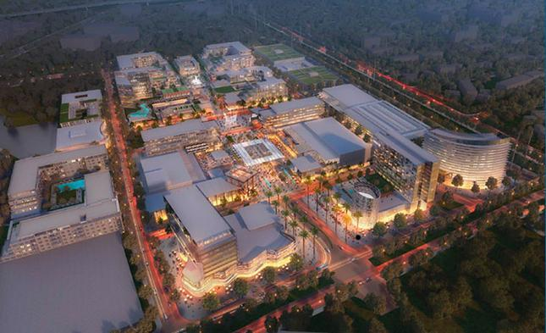
Safe Development at Contaminated Sites

Slide 4
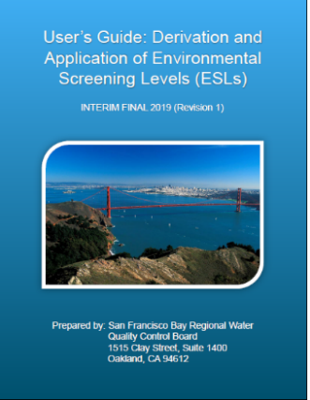
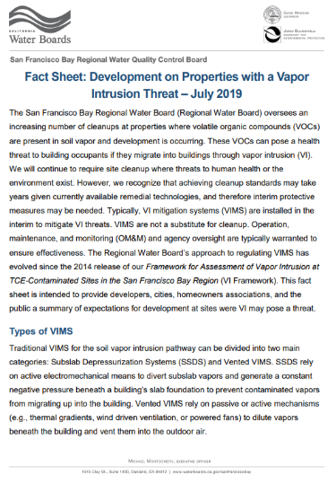
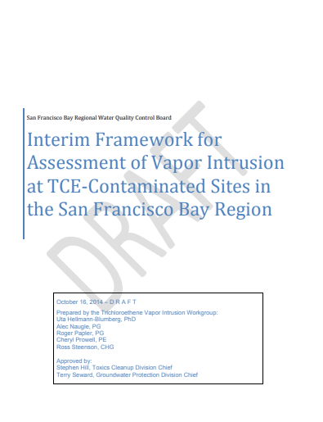
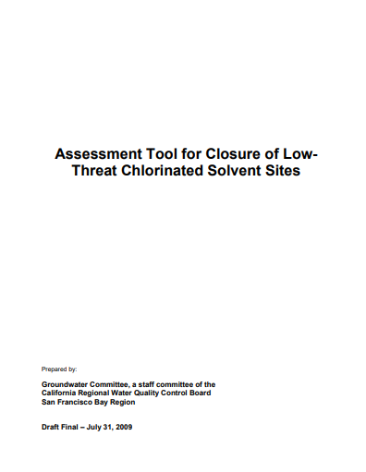
Response to Redevelopment: Guidance Updates
Environmental Screening Levels, July 2019
Fact sheet: Development on Properties with a Vapor Intrusion Threat, July 2019
Vapor Intrusion Framework, Planned update early 2020
Low Threat Assessment Tool, Planned update mid 2020

Slide 5
Groundwater Quality
Emerging Contaminants
Sustainable Groundwater Management
Outreach/Recycled Water Policy
Notes:
Grants

Slide 6
Addressing Impaired Waters
Implementation Plans – Petaluma River, Tomales Bay (Walker Creek, Lagunitas Creek), Napa River, Sonoma River
Irrigated Lands – Vineyards and Cannabis
On-site Wastewater Treatment
Grazing and Confined Animal Facilities
Notes:
Grants

Slide 7
Stormwater/Wastewater
Municipal Regional Stormwater Permit
Industrial Non-filers
Restoration Project Permitting (Measure AA)
Nutrients Permit
Reducing Sanitary Sewer Overflows

Slide 8
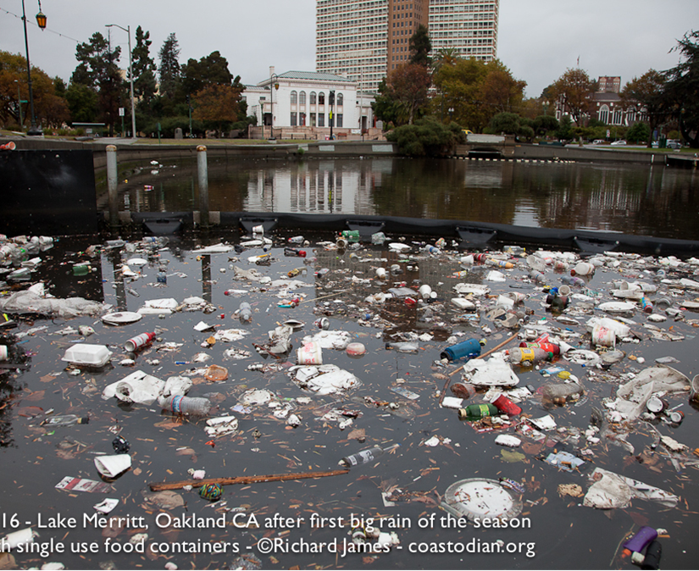
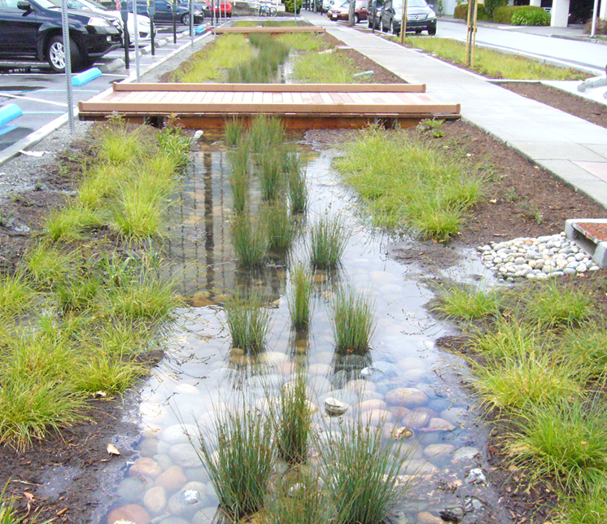
Stormwater Challenges
Control trash and pollutants of concern
Shift to green from gray infrastructure
Address discharges associated with homelessness

Slide 9
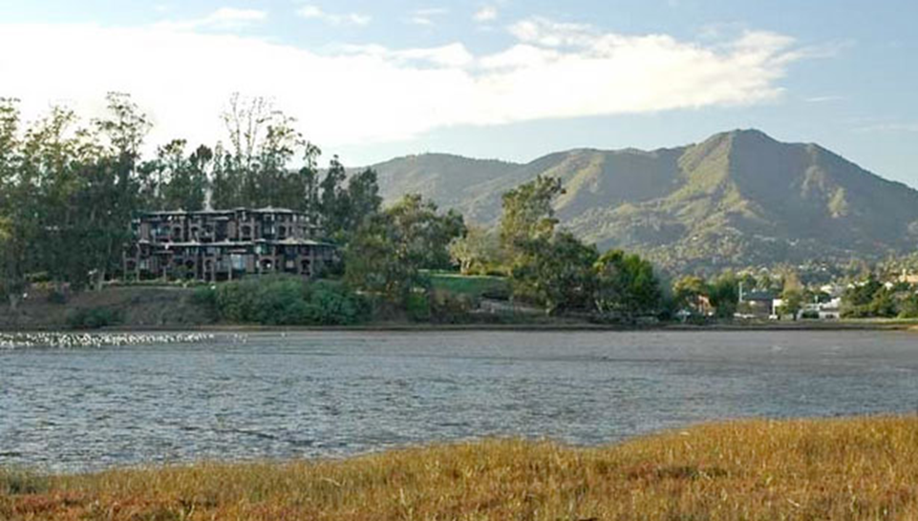
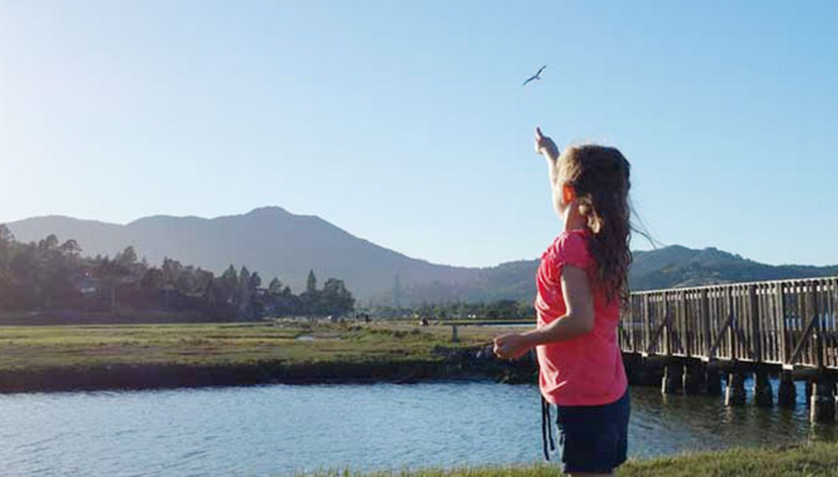
Climate Change/Water Resilience Priority
Innovative Permitting
Regional Collaborations
Sea Level Rise Basin Plan Amendment
Marin County Parks - Bothin Marsh

Slide 10
Questions?

