Slide 1


Rational Mistrust?
The Role of Infrastructure Neglect in Under-reliance on the Tap in Disadvantaged Urban Communities
Gregory Pierce
gspierce@ucla.edu
Sept 2, 2022

Slide 2
Defining Terms: Safe, Clean and Mistrust
Tap water is safe when it does not violate primary, health-related standards
Tap water is clean when the water provided does not violate “secondary” standards mostly related to color, taste or smell
Mistrust occurs when customers do not believe their tap water is safe for drinking
Research suggests that customers are more likely to mistrust their tap water when it is unclean than when it is unsafe

Slide 3
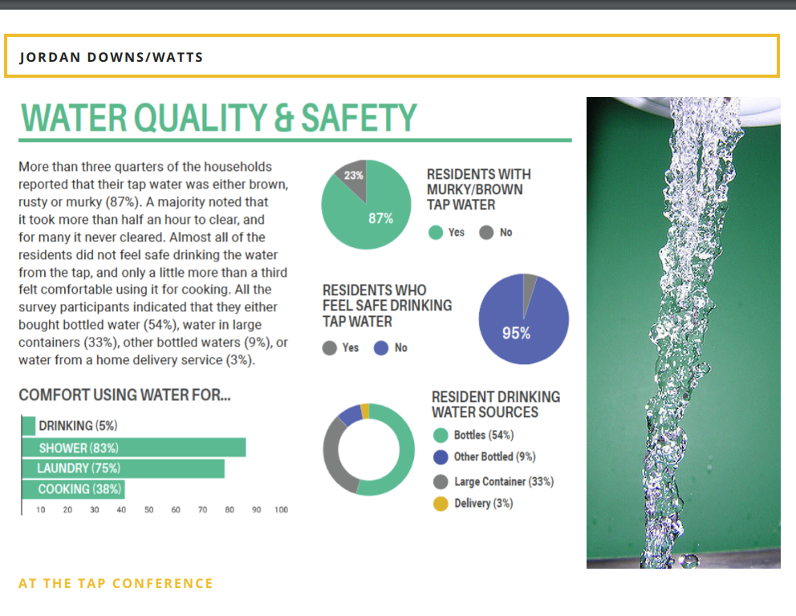
Concentrations of Urban Mistrust at the Tap

Slide 4
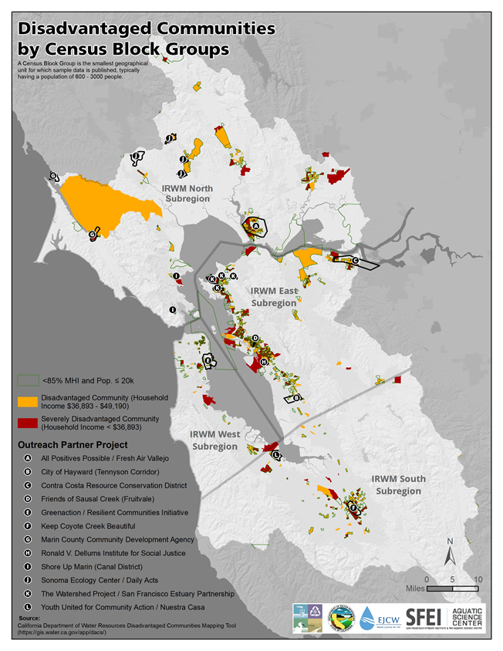
Disadvantaged Communities and Tribal Involvement Program
Goals and Objectives
Work with disadvantaged, economically distressed, underrepresented, and tribal communities to:
Document needs
Identify possible solutions
Develop projects to implement the solutions
Obtain implementation funding in 2021
Process
Community Outreach Partners/Tribal Organizations contracted to:
Conduct Needs Assessment surveys & community meetings
Develop Project Concept Proposals
Notes:
This is not your typical IRWM Grant

Slide 5
Regional Tap Water Quality Testing Program: Building Community Engagement and Trust in Drinking Water

Slide 6
Consequences of Mistrust
Individuals who mistrust tap water rely on tap alternatives which cause:
  Negative health effects
  High out of pocket expenditure
  Stress and indignity
Additional negative impacts include:
  Environmental externalities
  Systems’ revenue and public confidence

Slide 7
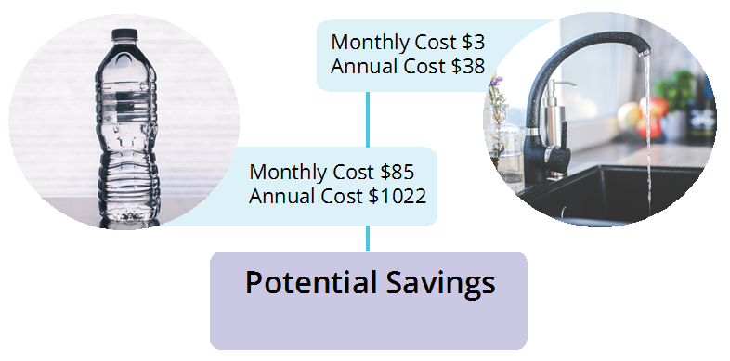
Illustrating Consequences
Source: Peter Roquemore and Gregory Pierce (2019). Stopping the Drain On Household Budgets: Financing Upgrades to Premise Plumbing for Drinking Water in Los Angeles

Slide 8
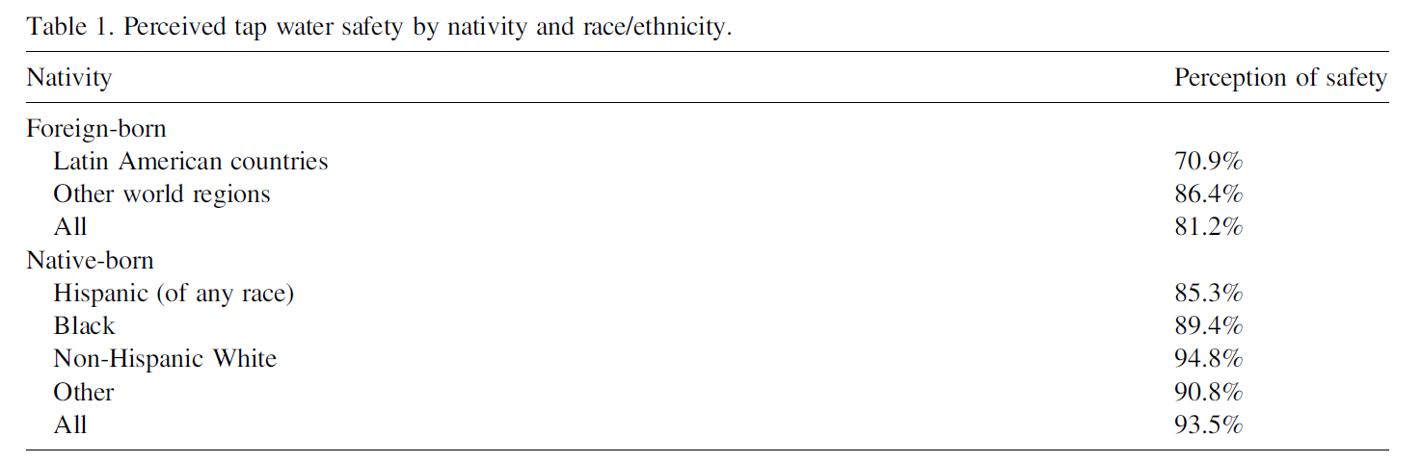
Past Research on Mistrust: SES and Experience
Sources:
Gregory Pierce and Silvia Gonzalez (2016). “Mistrust at the Tap? Factors Contributing to Tap Water (Mis)Perception across the United States.” Water Policy.
Ariana Javidi and Gregory Pierce. Negative Drinking Water Perception's Severe Consequences: Examining Constrained Alternative Choices to the Tap (Water Resources Research)
Notes:
Research shows heightened mistrust:
Minority, esp. Latino, households most likely to mistrust the tap
African American households are most likely to rely on bottled water

Slide 9
Past Research on Mistrust: Misperception
  Mistrust framed as behavioral rather than rational response in disadvantaged communities
  “Future interventions should encourage tap water use by dispelling misconceptions and educating low- income people in urban areas of LA County”
  Source: Family et al(2019). Reasons why low-income people in urban areas do not drink tap water. The Journal of the American Dental Association.

Slide 10
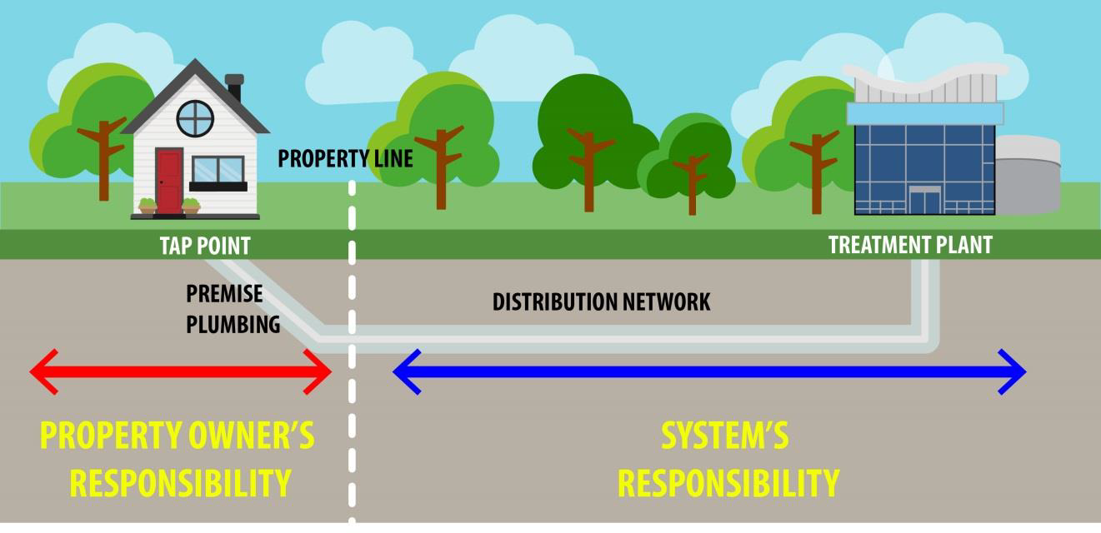
Potential Origin Points of Tap Water Mistrust
Source: Trouble Between Testing and the Tap: Addressing Under-regulated Causes of Mistrust in Drinking Water System Supply. Gregory Pierce, Silvia Gonzalez, Peter Roquemore and Rebecca Ferdman (submitted to Environmental Health Perspectives)

Slide 11
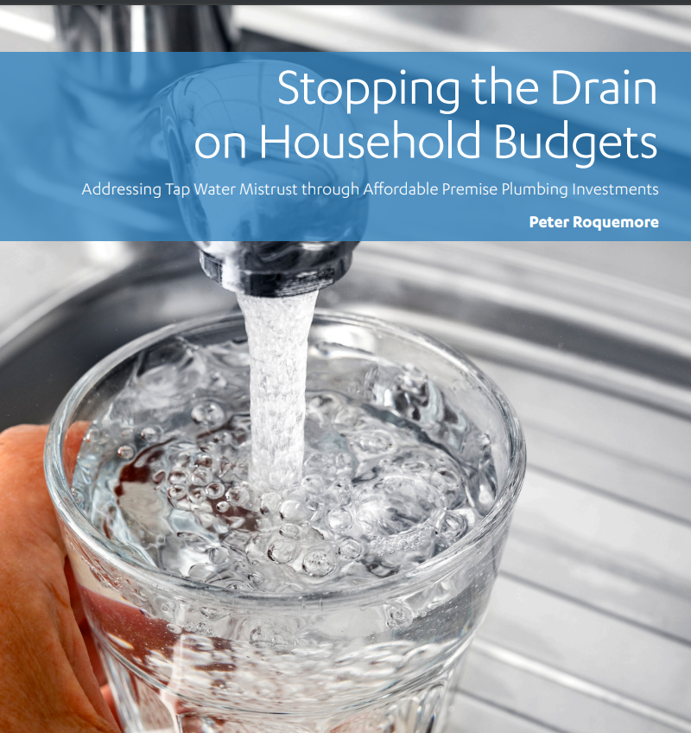
Results: Infrastructure Contributions in LA City

Slide 12
Stakeholders who need to be involved:
Given the complexity and diffused responsibility and authority to address tap water distrust concerns, the following stakeholders can and should all take active steps to effect solutions:
1) concerned residents;
2) local government decision-makers;
3) County Public Health;
4) affected water systems;
5) State Division of Drinking Water; and
6) legal advocacy groups

Slide 13
Bay Area Process (Wrapped up)
Community & Tribal Partners to choose from pre-set analyte panels
SimpleLab to furnish Community & Tribal Partners with DIY Sampling Kits
Samples sent to labs via USPS; optional digital notes, photographs, and point-of-test surveys collected
SimpleLab to provide lab results in PDF (paper) or html (online) formats
Community & Tribal Partners to organize follow-up community meetings

Slide 14
Top Draft Lessons learned from Bay Area
Stakeholders at all points in the process will have many Qs and desire for ad hoc conversations….only so much can plan this out v. have built in flexibility
One must try, but information cannot be explained to all stakeholders’ satisfaction
How to advise CPs on what to test for…different priorities here
How to measure WQ issues of concern and trust/affordability rigorously, while respecting survey fatigue
Few testing firms (labs) to do this work
Providing filter information (different opinions and tradeoffs here)
Few premise plumbing solutions once problems are identified…what is the path forward or is this work inherently limited to problem identification

Slide 15

Questions?
gspierce@ucla.edu

