Slide 1

North Bay Watershed Association
Board Meeting
October 7, 2022

Slide 2
1. Welcome and Call to Order –
Roll Call and Introductions

Slide 3
2. General Public Comments
This time is reserved for the public to address the Committee about matters NOT on the agenda and within the jurisdiction of the Committee.

Slide 4
3. Agenda and Past Meeting Minutes Review, and Draft September Treasure’s Report
Proposed Action: Approve/ Review

Slide 5
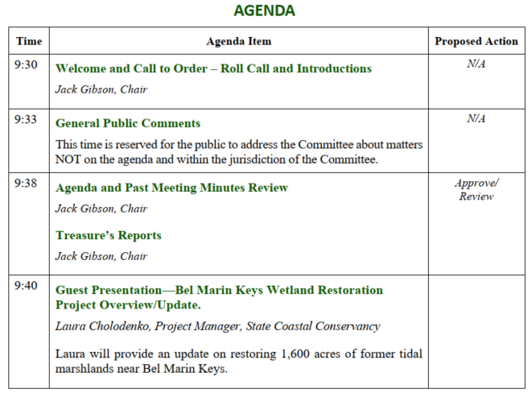
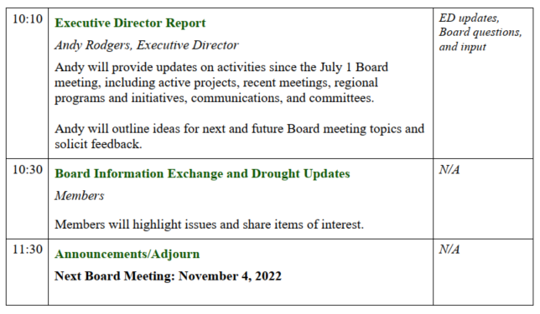

Slide 6
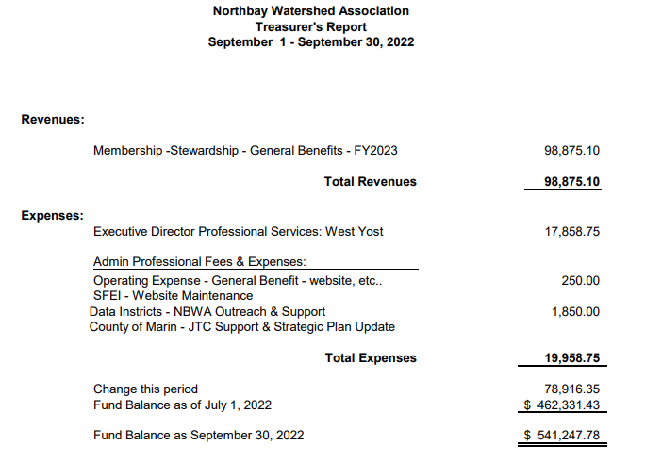
Treasure’s Report
September 2022
Proposed Action: Accept
Board Meeting | October 7, 2022

Slide 7
4. Guest Presentation— Bel Marin Keys Wetland Restoration Project Overview/Update
Jessica Davenport, Deputy Program Manager
Jessica will provide an update on restoring 1,600 acres of former tidal marshlands near Bel Marin Keys.

Slide 8
4. Guest Presentation—Overview Novato Sanitary District & BMK V Wetland Restoration Project
.

Slide 9
Overview
Novato Sanitary District
&
BMK V Wetland Restoration Project
North Bay Watershed Association (NBWA)
October 7, 2022

Slide 10
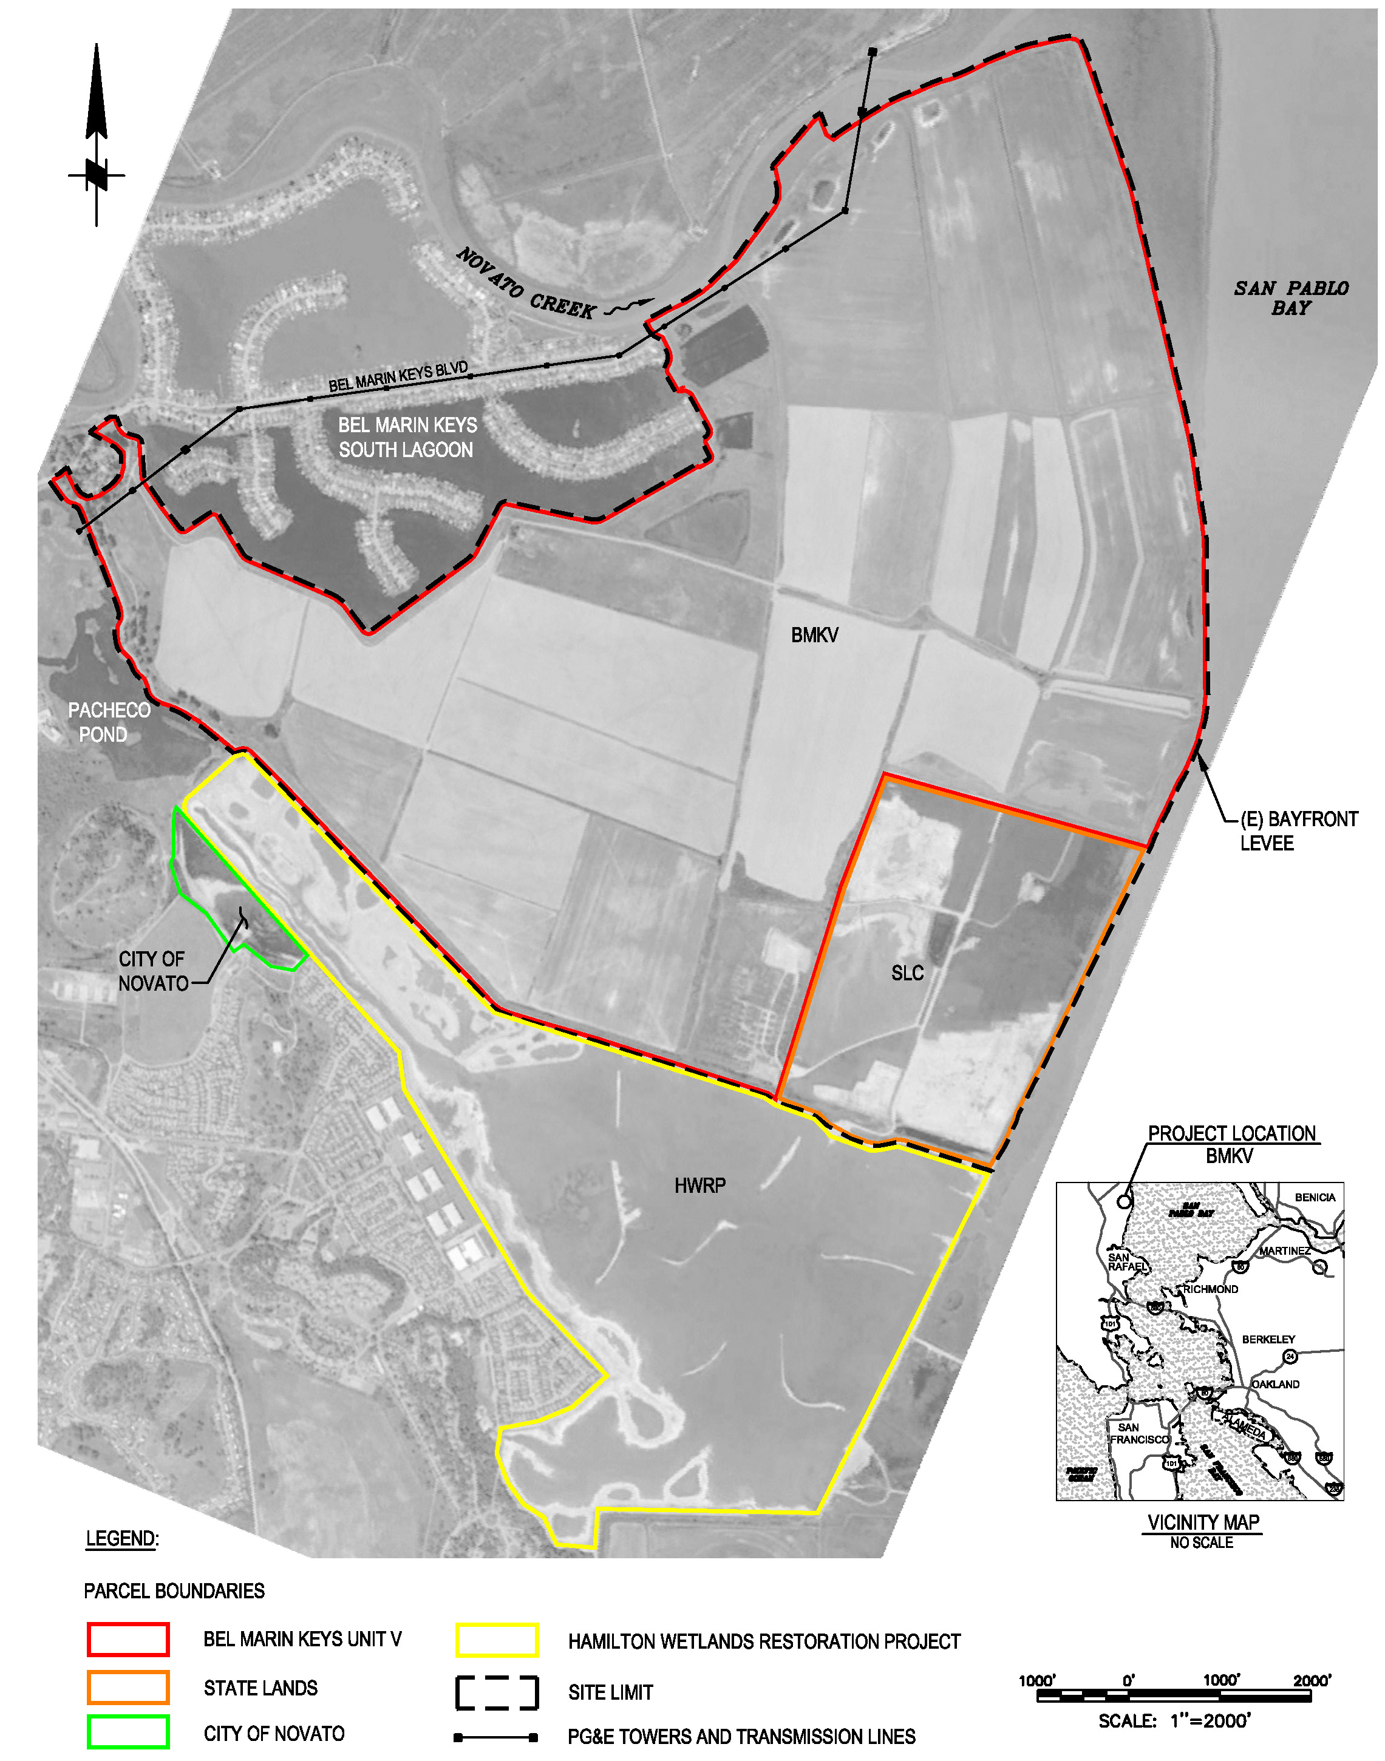
Hamilton Wetland Restoration Project
BMKV Project
State Lands Commission parcel
Restored Airfield

Slide 11
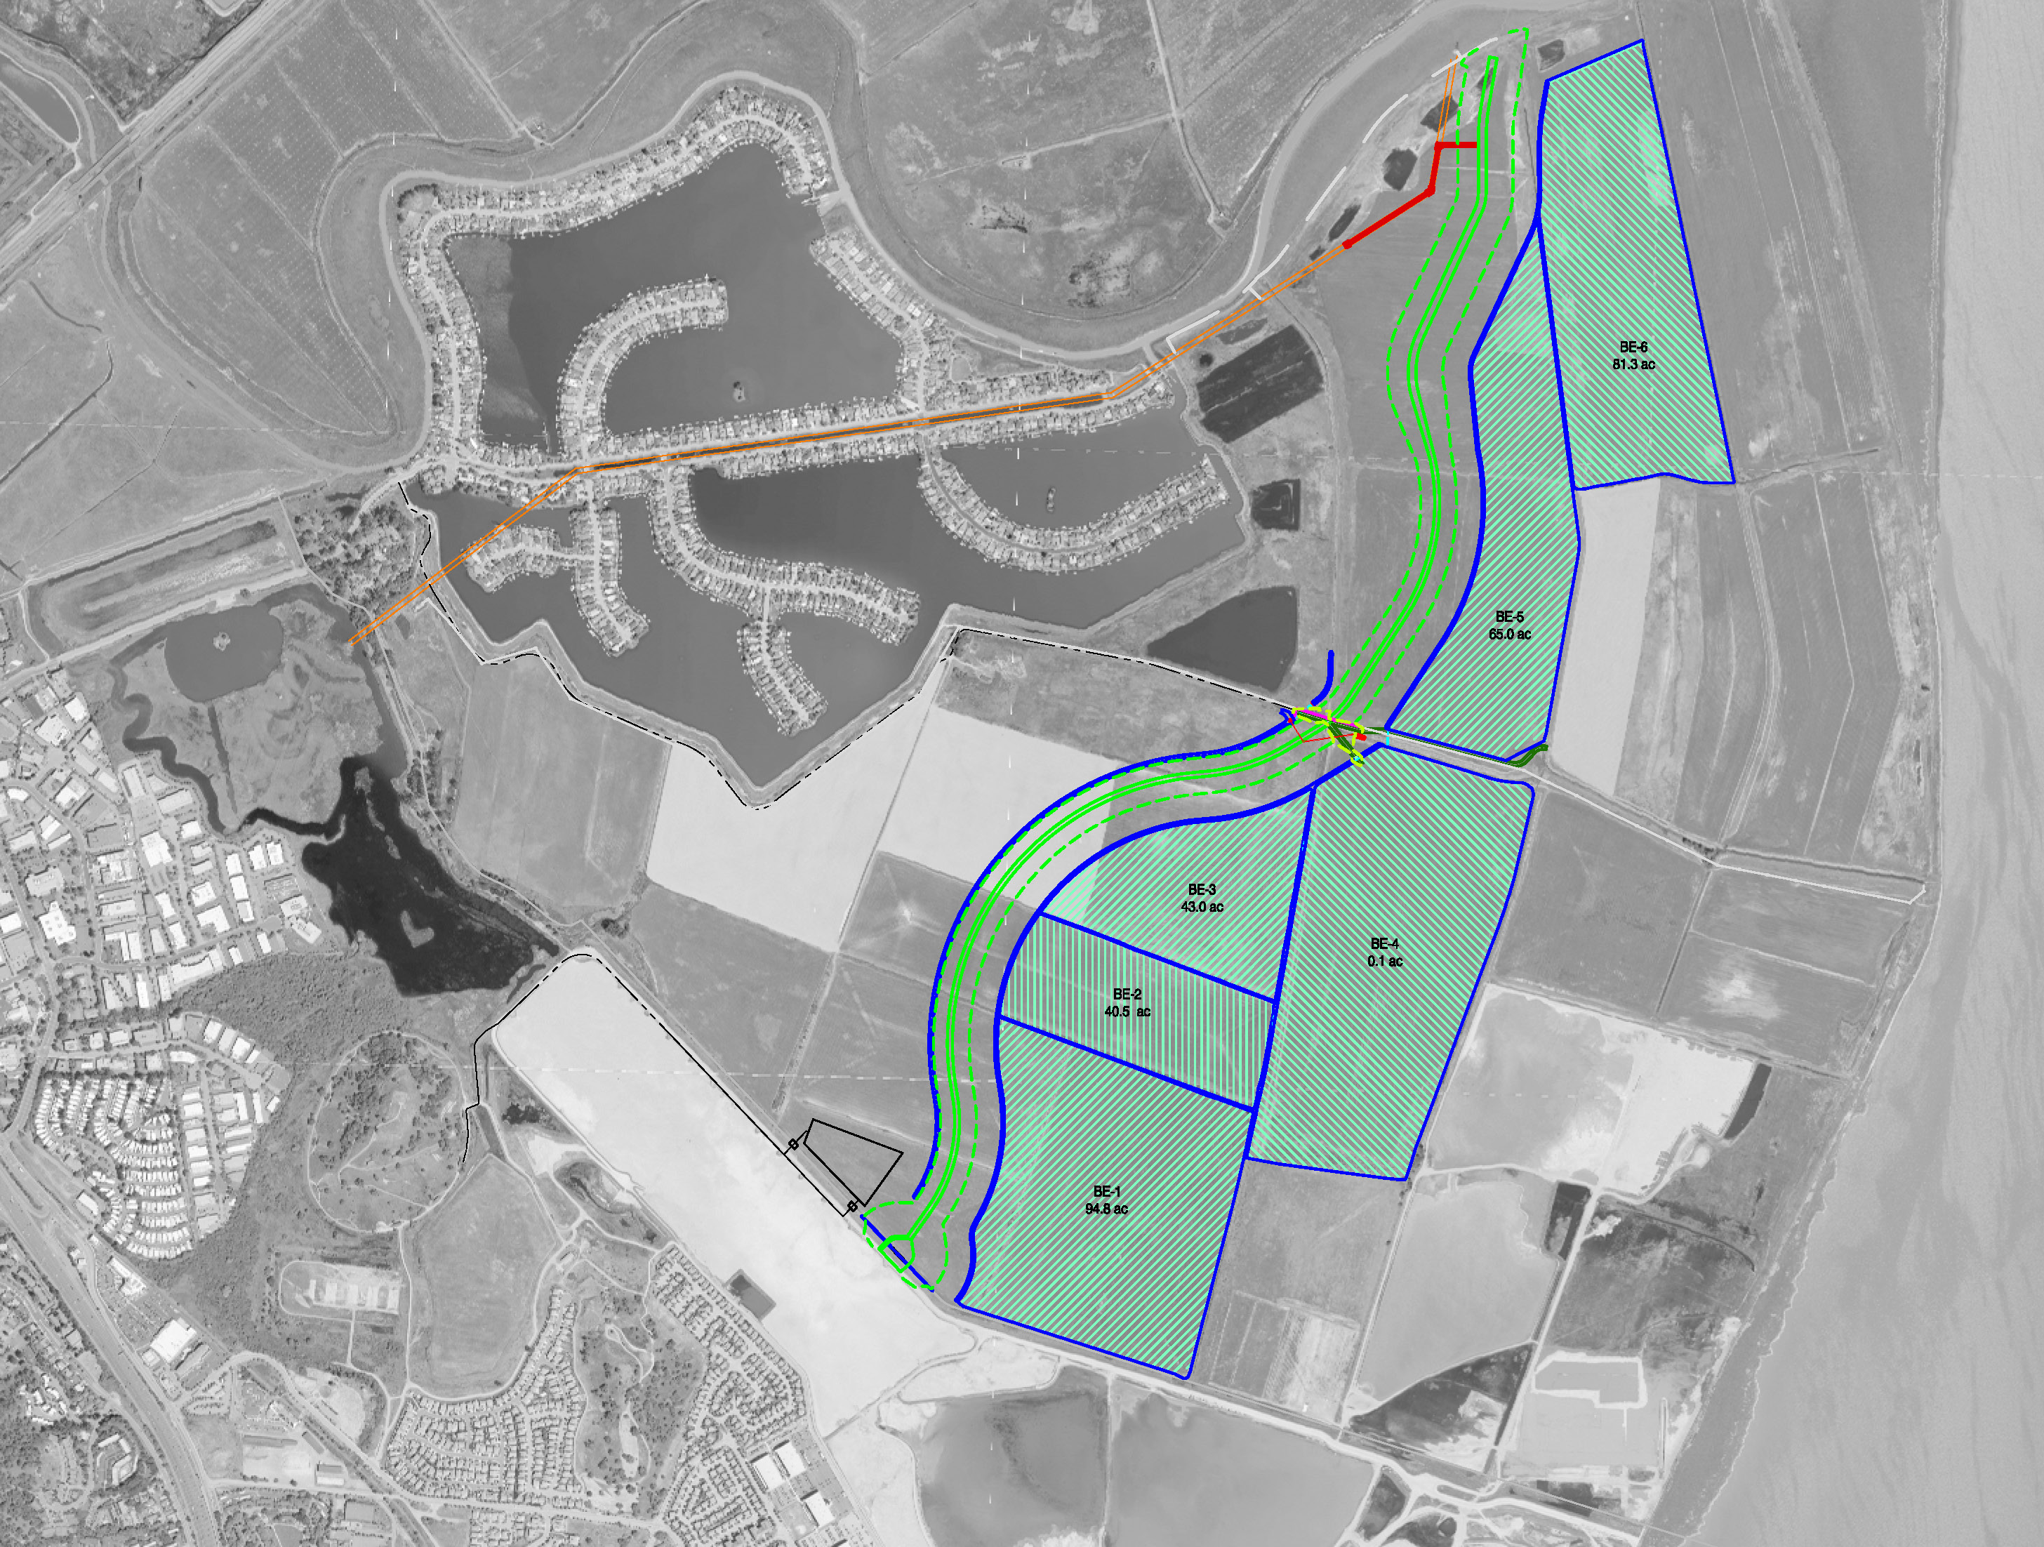
BMKV Phase 1 Restoration- Levee Construction
Levee Design:
11,800-ft long
1,300,000 cubic yards
Bayside borrow

Slide 12
NSD Treated Effluent Pipeline Modification

Slide 13
NSD Support to Project
Close coordination with SCC staff and consultants during design and construction.
Agreement to provide the project with treated effluent water for dust control and irrigation to establish vegetation.
Over 40 million gallons of treated effluent supplied over course of the project.
Negotiated with Regional Water Board to modify NSD discharge permit to allow discharge to the newly created wetland to propagate and enhance desired brackish marsh.

Slide 14
Recent Developments and Next Steps
State recently allotted >$20M for the final stage of the project.
NSD will continue to coordinate closely with SCC as design and construction move forward.
Final project will relocate NSD discharge point, transitioning from shallow water in San Pablo Bay to direct discharge to the new brackish wetland.

Slide 15
5. Executive Director Report
Andy Rodgers, Executive Director
Andy will provide updates on activities since the July 1 Board meeting, including active projects, recent meetings, regional programs and initiatives, communications, and committees.
Andy will outline ideas for next and future Board meeting topics and solicit feedback.

Slide 16
Executive Director Report
Updates since last meeting
Administrative Activities
Communications
Committees
Attended IRWM coordinating committee meetings July 25, Aug 22, Sept 26 – NBWA region well represented on PSC!
Attended CASQA legislative subcommittee meeting on July 26, Aug 23, Sept 27
Met with NBWRA on August 19 & Sept 27 to progress NBWA alignment initiative
Attended North Bay RCIS stakeholder workshop on Sept 8
Evaluated grant funding opportunities for regional programs
Met with SFEI to finalize website refresh scope of work on Sept 8
Programmed FY 2022-23 work plan
Coordinated with Board Chair, Deputy Director, Finance Manager
AR – Membership dues
AP – Subconsultants
Updated website and meeting packet information
Held first in-person meeting & field trip @ CMSA since covid Sept 2!
Prepared and distributed NBWA quarterly newsletter
Met with Napa County FCWCD Sept 27 to initiate meeting & field trip planning
Regional partners
Subject matter experts and speakers
Attended Land Use and Water Infrastructure initiative subcommittee meeting September 1
Met with Chair, Deputy Director, and staff to progress NBWA initiatives

Slide 17
NBWA FY 2022/23 Work Plan
Executive Director services
  Continue transition to in-person/hybrid (including tours) meetings
  Member communications and advocacy
  Convene Executive/Admin Steering Committee – December 2022/January 2023
    Prioritize and provide direction on implementing initiatives
Implement focused regional initiatives
  Water services infrastructure and land use/housing – Focused workshop #2, winter 2023
  Align missions and programs with NBWRA – Chairs meeting December 1, NBWA Board meeting Feb 3
  Annual General Managers meeting – March 2023
  Phase I (exploratory) DroughtSMART & FireSMART branding pilot – Winter 2023
  Proposal to support convening a series of ACWA-endorsed regional industry workshops
Participate in regional forums
  IRWM, RCIS, SFBRA, others
Convene Joint Technical Committee
  Programmatic planning and funding
Communications
  Quarterly newsletter
  Update NBWA website

Slide 18
Regional Updates
DWR SGM Implementation, Round 2 Solicitation Open
  Application Period: October 4-November 30, 2022, 5 pm
  Funding Available: $200M from the General Fund and Proposition 68
  Purpose: To promote healthy and sustainable groundwater basins
EPA's San Francisco Bay Water Quality Improvement Fund (SFBWQIF) FY 2022 RFA and the BIL-SFBWQIF FY22 RFA
  Deadline: September 20, 2022 at 9pm
  Funding Available: $24M (SFBWQIF) & $5M (BIL-SFBWQIF)
  Purpose: Protect and restore San Francisco Bay watersheds and wetlands and expand the SFBWQIF’s focus on building climate resilience in underserved communities.
San Francisco Bay IRWM Prop 1 Round 2 Implementation Funding Applications
  Deadline: October 10, 2022 at 12pm
  Funding Available: $25M for implementation projects plus $6.5M available for DACs
  Purpose: Encourage integrated regional strategies for water resource management including climate change adaptation, incentives for collaboration, setting water resource and infrastructure management priorities, and improving regional water self-reliance
State Route 37 Policy Committee
  Met on September 1, 2022
Notes:
https://www.sfbayrestore.org/announcement/epa-san-francisco-bay-water-quality-improvement-fund-2022-requests-applications-now
http://bayareairwmp.org/
https://scta.ca.gov/wp-content/uploads/2022/08/State-Route-37-Policy-Commitee-09.01.2022.pdf

Slide 19

Executive Director Report (continued)
Confirming 2022/23 calendar dates – First Friday of every month - Except of course for holidays!
FY 2022-23 Board Meetings
November 4 – In person/hybrid
December 2 – Field trip
January 6 – potential skip month
February 3 - In person/hybrid
March 3 – In person/hybrid
April 7 – Field trip
May 5 - In person/hybrid
June 2 – Field trip?

Slide 20
Board Meeting Topics Outlook
Topics in development:
  Regional Resiliency (Nov 4), SFBay Basin Plan Amendment (Nov 4 or Feb 3), Napa County Field Trip (Dec 2), Environmental Education & Grant Funding (March 3), Solano County Field Trip (April 7), Urban Scale Carbon Sequestration Initiatives (April 7) Regulatory Compliance Partnerships, Baylands Strategies, DroughtSMART/FireSMART, OneWater OneBay Strategic Initiatives, DWR & SWRCB Drought Assistance Programs and Resources, Collaboration-Based Funding Opportunities, Water Management & Conveyance Innovations, Capital and Natural Assets Management, Small Grants and Scholarship Program, New Members!

Slide 21
6. Board Information Exchange and Drought Updates
Members
Members will highlight issues and share items of interest.

Slide 22
Announcements/Adjourn
Next Board Meeting:
November 4, 2022
www.nbwatershed.org

