Slide 1
Bay Area Integrated Regional Water Management
NBWA Executive Board
Integrated Regional Water Management Program Overview and 2019 Plan Update

Slide 2
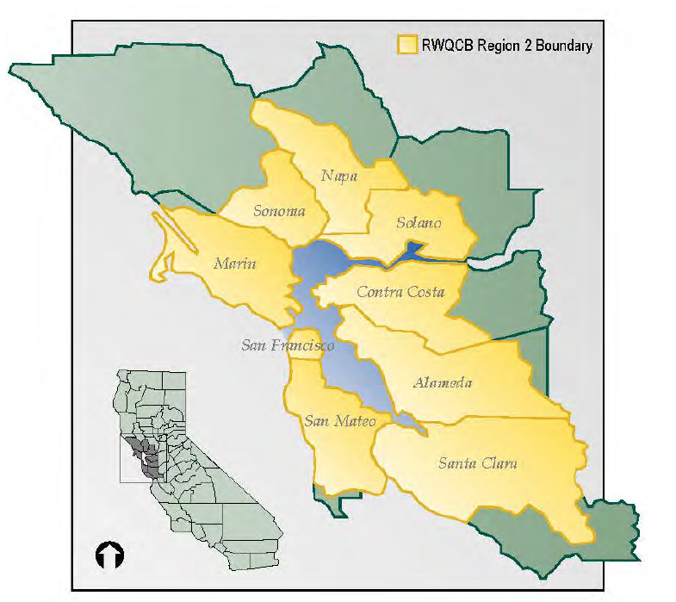
SF Bay Funding Area
Proposition 84 (2006) | Grant Amount | Year
Round 2 Implementation | $20,000,000.00 | 2014
Round 3 Implementation | $32,178,423.00 | 2015
Round 4 Implementation | $21,469,025.00 | 2016
Proposition 1 | Grant Amount | Year
Disadvantaged Community and Tribal Involvement Program | $3,020,000.00 | 2019
Round 1 Implementation | $ 22,750,000.00 | 2020
Total | $99,417,448

Slide 3
North Bay Projects
Proposition 84
Round 2
6 Projects
$4,495,000 (22%)
Round 3
4 Projects
$6,632,952 (20%)
Round 4
2 Projects
$4,333,170 (20%)
Proposition 1
DACTIP
Marin, San Rafael, Point Reyes, Dillon Beach, & southern Sonoma County
Round 1
2 Projects
$6,090,078 (27%)
Round 2 (2021)
$22,750,000 available
$21,551,200

Slide 4
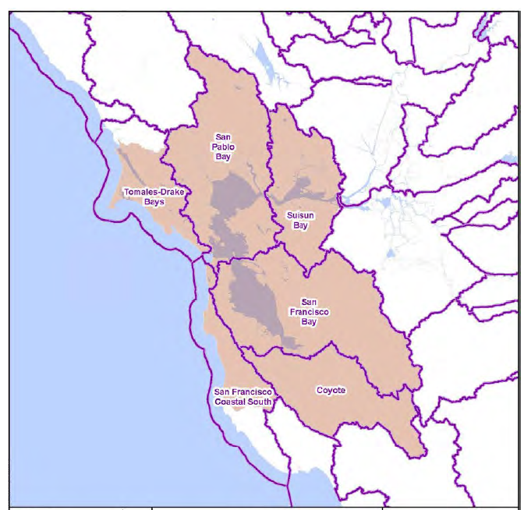
Hydrologic Characteristics
Complex network of watersheds, marshes, rivers, creeks, reservoirs, and bays predominantly draining into the San Francisco Bay and Pacific Ocean
Biggest impacts to hydrologic function of Bay Area Region watersheds are urbanization and land practice alterations

Slide 5
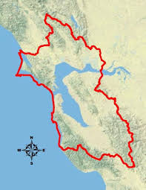
What is the BAIRWMP?
The Bay Area Integrated Regional Water Management Plan is a nine-county effort to address the following critical needs:
Promote environmental, economic and social sustainability
Improve water supply reliability and quality
Protect and improve watershed health and function and Bay water quality
Improve regional flood management
Create, protect, enhance, and maintain environmental resources and habitats

Slide 6
What kinds of projects are included?
Projects are under four broad Functional Areas:
Water Supply / Water Quality
Wastewater / Recycled Water
Flood Control / Stormwater
Habitat / Watersheds

Slide 7
Bay Area IRWM Governance
The Bay Area region has a Coordinating Committee (CC), which is open to the public and includes representatives from each of the four functional areas, and each of the four sub-regions.
CC is the Regional Water Management Group (RWMG) for the IRWMP.
12 voting representatives, 3 each from each functional area
CC meets monthly

Slide 9
2016 IRWM Guidelines
The 2016 IRWM Guidelines updated and created new standards in the following sections:
Region Description
Plan Objectives
Resource Management Strategies
Project Review Process
Plan Performance and Monitoring
Local Water Planning
Local Land use Planning
Stakeholder Involvement
Climate Change
Many of the required updates directly related to Climate Change
More detail on these required updates can be found in Appendix H of the 2016 IRWM Grant Program Guidelines
The state requires all regions in California to update their plan before receiving Proposition 1 Implementation funding

Slide 10
2016 IRWM Plan Guidelines
Major Takeaways
23 Plan Standard updates
11 updated requirements
12 new requirements
The updated and new requirements focused on
Climate Change impacts, adaptation, & mitigation
Reducing energy Green House Gas emissions
Tribal inclusion and recognition
Ongoing IRWM plan updates and regional collaboration

Slide 11
Process
The process to update the plan to conform to 2016 standards was led by the SFPUC in consultation with DAC and Tribal representatives
The updates were posted for public comment. Comments were received and addressed.
The CC unanimously approved them
The updated plan was submitted to DWR in November 2019 and approved in March 2020

Slide 12
Bay Area IRWM Plan UPdate
Many of the new and updated DWR standards were already met
Robust changes were made to address DAC and Tribal language in relevant sections
Minimal climate change language was added
The project list was updated
Governance will be addressed in a future Bay Area IRWM Plan update to include DAC and Tribal voting members

Slide 13
Thank You!
More info can be found online at:
http://bayareairwmp.org/
James Muller
Principal Environmental Planner: ABAG/SFEP/MTC
James.muller@sfestuary.org

Slide 14
Bay Area - Updated Sections (Reference Only)
1.2.2.1 – Identification of Stakeholder Types
1.3.1 – Public Outreach and Involvement Process
1.4.2 – Outreach to Disadvantaged Communities and Native American Tribes
1.7 – Interim and Formal Changes to the Plan and Plan Updates
2.2.7 – Biodiversity and Protected Lands
2.2.10 – Social and Cultural Makeup
2.2.13 – Native American Tribal Communities
3.2.3.1 – Prioritizing the Objectives
6.3.2.1 – Targeted Assistance for DAC Project Proponents
7.6.1 – Habitat Protection and Improvement
7.11.1 – DACs in the Bay Area Region
7.11.3 – Current Projects in DACs
7.12 – Effects on Native American Tribal Communities
13.1 – Land Use Planning in the Bay Area
14.5.3 – Participation in the Coordinating Committee
14.5.5 – General Outreach Materials and Distribution
14.6.1 – Approach to DAC Engagement
14.6.5 – Targeted DAC Outreach and Engagement
14.6.7 – Disadvantaged Community and Tribal Involvement Program
14.7 – Native American Tribe Identification and Outreach
14.8 – Stakeholder Engagement Following Adoption of the IRWMP

