Slide 1
Russian River Watershed Resiliency Pilot Project
Presented by:
Chris Delaney, Sonoma Water
North Bay Watershed Association
10/4/2024

Slide 2
California Department of Water Resources (DWR) Watershed Resilience Program Goals
Use limited State funds to develop and incentivize diverse, inclusive watershed networks to understand climate vulnerabilities, formulate adaptation strategies, and track outcomes to improve regional climate resilience.
Pilot projects would implement the policies described in the Water Plan and help refine a watershed resilience approach that builds off of the IRWM Program.
DWR 2024

Slide 3
Watershed Resilience Program DWR’s Intent and Anticipated Outcomes
Program Intent
Empower local water leaders with the capacity to prepare for climate change impacts across water sectors at the watershed scale
Equity
Climate Science
Scale
Build and support inclusive and diverse watershed networks​
Inform sound resilience planning with quantitative climate vulnerability and adaptation analysis
Incentivize planning on a hydrologically appropriate scale, from headwaters to groundwater basins

Slide 4
Pilot Project Grantees
Funded and managed by DWR.
$10M equally allocated to 5 pilots.
Watersheds selected throughout the state.
Eligible entities – public agencies
Watershed | Agency | Budget
American River | Regional Water Authority | $2M
Calaveras | Stockton East Water District | $2M
Pajaro River | Pajaro Valley Water Management Agency | $2M
Russian River | Sonoma County Water Agency | $2M
Ventura | Ventura County Resource Conservation District | $2M

Slide 5
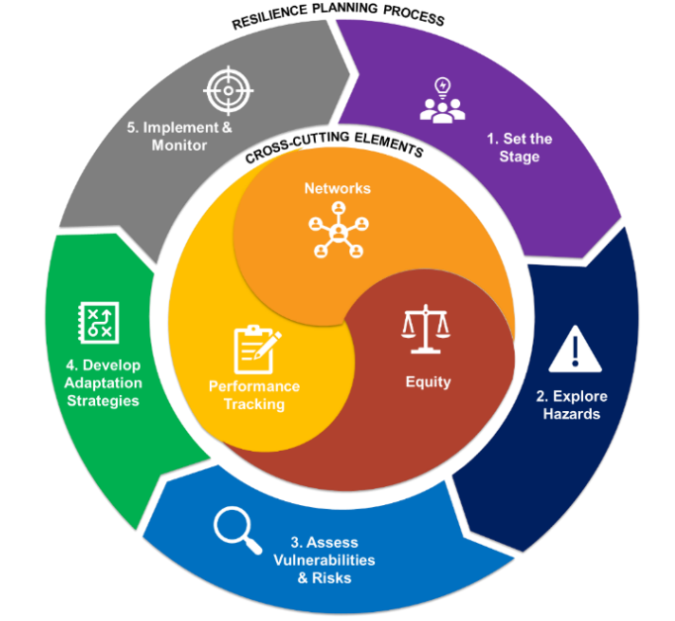
Watershed Resilience Planning Process
Steps for Resilience Planning:
Step 1: Set the Stage
Step 2: Explore Hazards
Step 3: Assess Vulnerabilities and Risk
Step 4: Develop Adaptation Strategies
Step 5: Implement and Monitor
Figure provided by DWR

Slide 6
Water Equity Defined by the U.S. Water Alliance
Water equity occurs when all communities:
Have access to clean, safe, affordable drinking water.
Are resilient in the face of floods, drought, and other climate risks.
Have a role in decision-making processes related to water management in their communities.
Share in the economic, social, and environmental benefits of water systems.

Slide 7
Step 1 – Set the Stage
Identify
Existing
Networks
Watershed
& Planning
Boundary
Form the
Watershed
Network

Slide 8
Watershed Network
A Network will be assembled to represent the broad interests within the watershed.
Will provide crucial feedback on the Watershed Resilience Vision and the development of the Watershed Resilience Plan.
A Steering Committee will be assembled from key members of the Watershed Network to assist with project decision making.
Local Governments | Resource Agencies
Community Groups | Water Agencies & Irrigation Districts
Agricultural Users | Groundwater Sustainability Agencies
Vulnerable Communities | Environmental Organizations
Tribal Governments | Flood Management and Stormwater

Slide 9
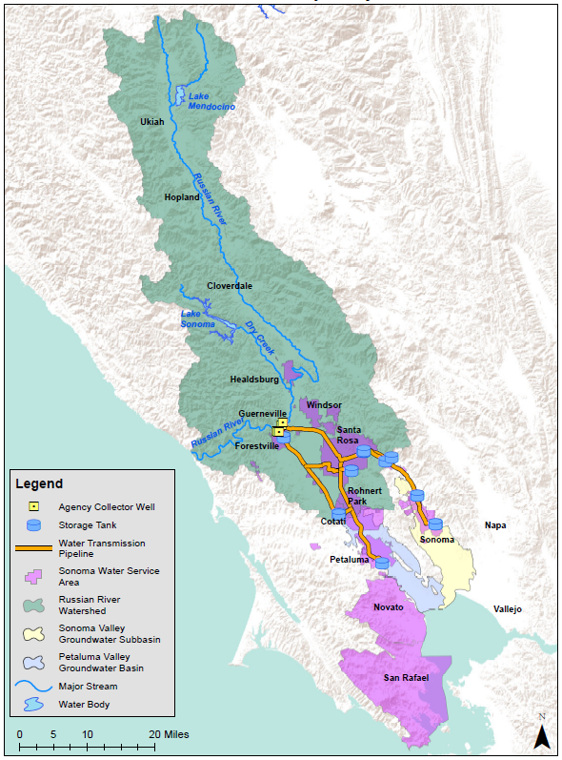
Preliminary Project Area
Preliminary Project Area includes Sonoma Water’s water supply service areas. Project Area will be finalized based on input from the Watershed Network.
These areas are highly influenced by the import of water from the Russian River and includes three Groundwater Sustainability Agencies.

Slide 10
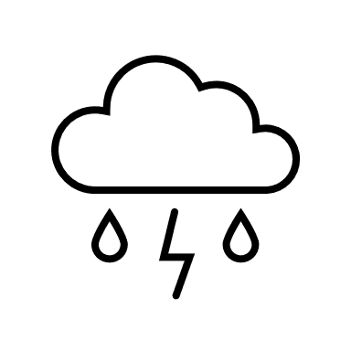
Step 2 – Explore Hazards
State of
Resilience
Planning
Historical
Weather
Events
Climate
Trends

Slide 11
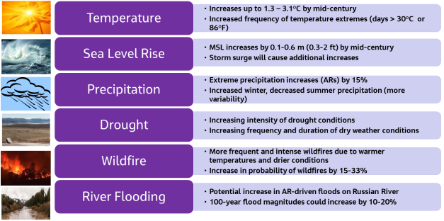
Climate Hazards
Sonoma Water Climate Adaptation Plan, 2021
Hazard assessments will use latest CMIP6 climate projections.

Slide 12
The Focus is on Water and Climate
Primary Water Sectors:
Water Supply
Groundwater
Flood Management
Water Quality
Ecosystems
Recreation
Hydropower

Slide 13
Step 3 – Vulnerability Assessment
Metrics & Thresholds
Watershed
Water Budget
Assess
Vulnerability

Slide 14
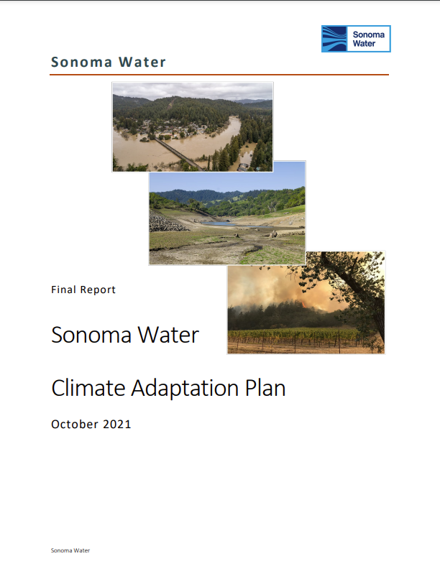
Sonoma Water Climate Adaptation Plan
Expanded to a
watershed scale
Updated to
CMIP6

Slide 15
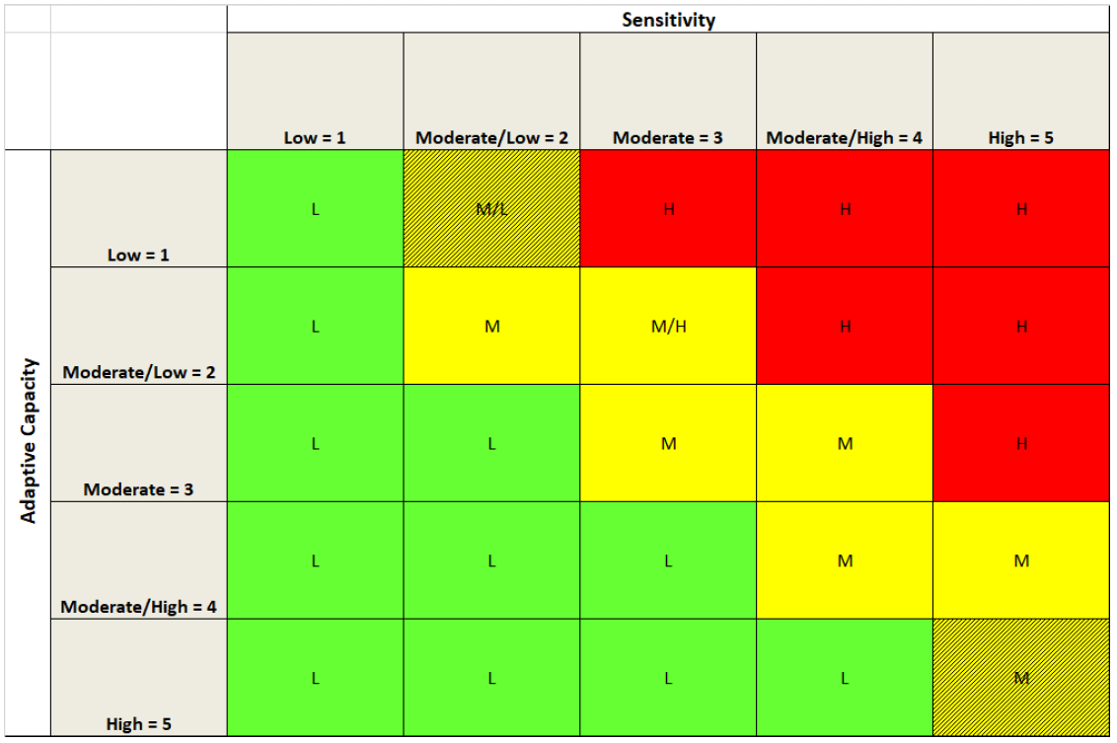
Assessment of Vulnerability Concept

Slide 16
Step 4 – Adaptation Strategies
Priority
Risk Areas
Adaptation
Strategy
Evaluation
Recommended
Strategies

Slide 17
Develop and Evaluate Watershed-Specific Adaptation Strategies
Prioritize risk areas
Qualitatively and/or Quantitatively evaluate level of risk reduction
Recommend adaptation strategies

Slide 18
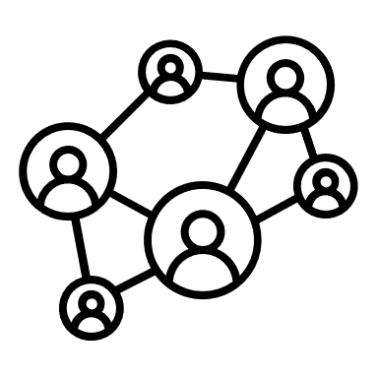
Step 5 – Implement and Monitor
Build
Support
Implementation
Plan
Stay
Flexible

Slide 19
Development of Implementation Plan
Adaptation strategy description
Specific Actions
Responsible leads
Supportive parties
Schedule
Implementation costs
Figure provided by DWR

Slide 20
Project Timeline
Spring-Summer 2024
Sign Agreement w/ DWR
DWR Kickoff Meetings
Fall 2024
First Quarterly Meetings
Ramping up network formation
Early 2026
2024-2025
Develop Watershed Resilience Plan
Develop Network
Define Project Area
Climate Vulnerability Analysis
Develop Adaptation Strategies and Implementation Strategies
Identify Performance Metrics

Slide 21
Near Term Next Steps
Contract with consultant team:
Lead: Jacobs Engineering
Outreach: Kearns & West
Technical Support: Environmental Science & Associates
Start development of Watershed Network
Develop water budget for the watershed
Begin climate hazard assessment
Continued engagement with DWR

Slide 23
Project Scope of Work
Build Inclusive Watershed Networks
Define Project Area ​
Project includes significant outreach efforts to engage:
Vulnerable communities
Tribes
Other stakeholders
Use latest climate science to assess watershed vulnerabilities and inform robust strategies.
Explore Climate Hazards ​
Assess Climate Vulnerabilities and Risks ​
Develop and Evaluate Adaptation Strategies​
Develop Implementation Strategies
Develop Tracking Metrics​
Develop Watershed Resilience Plan ​

Slide 24
Assess Climate Vulnerabilities and Risks
Use the latest climate projections:
Coupled Model Intercomparison Project 6 (CMIP6)
Downscaled hydrology using the USGS Basin Characterization Model (BCM)
Evaluate risks for multiple water sectors
Identify priority risk areas based on level of risk
Build from previous climate resiliency assessments
Sonoma Water Climate Adaptation Plan (2021
Regional Water Supply Resiliency Plan (to be completed in 2024)
Sonoma County Flood Resiliency Study (ongoing)
Surface Water Supply | Groundwater
Flood Risk | Water Quality
Ecosystems | Wildfire

